Slide 1
HIV-Hepatitis C Virus Co-infection:
An Evolving Epidemic
Marina B. Klein, MD, MSc, FRCP(C)
Division of Infectious Diseases and Chronic Viral Illness Service
McGill University Health Centre

Slide 2
HCV Genotype
Genotypes 1-6
  62% genotype 1 in Canada
  1, 3 more in IDUs
  Genotypes 2a and 5 are more frequent in patients previously exposed to multiple injections, surgery, or transfusions
  Type 4 more in African immigrants
  Existence of several genotypes in Canada despite low prevalence of HCV reflects the diversity of the population and active immigration
Most important predictor of IFN treatment response
Does not predict amount of liver damage
Andonov A, Chaudhary RK. J Clin Microbiol ,1994.
Notes:
2
There are at least 6 major HCV genotypes worldwide, designated as genotypes 1 through 6. Genotypes 1a and 1b are the most common commonly referred to as “hepatitis C, genotype 1.” Genotype 1 accounts for approximately two thirds of all HCV infections in Canada, whereas genotypes 2 and 3 cause most of the remaining infections. Genotype 3 predominates among injection drug users (IDUs) in Europe and Australia. Genotype 4 infections are most frequently seen in Canada among persons born in Africa.
The HCV genotype is the most important predictor of response to antiviral treatment. Genotype 1 is usually associated with a poor response to treatment with interferon and ribavirin, whereas genotypes 2 and 3 are more amenable to treatment. It was once thought that Genotype 1a and 1b were indistinguishable from one another clinically. However, recently it has been recognized with the advent of direct acting antiviral agents, that Genotype 1b infections respond more readily to treatment. By contrast, most studies suggest that genotype does not correlate with disease severity or influence the pathogenesis of liver disease. Genotype 3 infections however are associated with increased risk of hepatic steatosis.

Slide 3
Hepatitis C: A Worldwide Epidemic
Estimated ~ 170 million (3.1%) globally (2003)
Canada
242,000
(0.7%)
1, 2, 3
Europe
8.9 million
(1.03%)
1
Western Pacific
62.2 million
(3.9%)
1, 3
The Americas
13.1 million
(1.7%)
4
3
Asia: 6
4
3
1,3
Southeast Asia
32.3 million
(2.15%)
4
Eastern Mediterranean
21.3 million
(4.6%)
Africa
31.9 million
(5.3%)
1
4,5
Most Common Genotype
Worldwide: 6
World Health Organization. Hepatitis C: global prevalence: update. 2003.
Farci P, et al. Semin Liver Dis. 2000. Wasley A, et al. Semin Liver Dis. 2000.
Remis, for the Public Health Agency of Canada. Modeling the Incidence and Prevalence of Hepatitis C
Infection and its Sequelae in Canada, 2007. Unpublished data, 2009.
Notes:
3
It is estimated by the World Health Organization that approximately 170 million individuals, or 3.1% of the world population, are infected with HCV—more than 4 times the number of people living with HIV. There is, however, considerable geographic variation in the prevalence of HCV infection.
In the Americas, approximately 1.7% of the population is currently living with HCV. It is estimated that approximately 0.7% of the Canadian population is infected with HCV (242,000 persons in 2007). Rates of new cases have been relatively stable since 2004 with approximately 13,000 persons being diagnosed each year. The primary mode for acquiring HCV in Canada is through injection drug use (63%). Reported rates of acute HCV declined from 2.5 per 100,000 population in 2004 to 1.6 per 100,000 population in 2006. Since then, there has been a reversal of the downward trend, with the preliminary reported incidence rate of acute HCV infection increased to 2 per 100,000 population in 2008 and data suggest that this increase may be driven by acute HCV infections diagnosed among females aged 15-24 years and among males aged 25-34 years.
Areas of higher prevalence include some countries of Africa, the eastern Mediterranean, southeast Asia, and the western Pacific. In some areas, the prevalence of infection exceeds 10% in the general population. For example, in Egypt, there are some areas in which one out of every 5 individuals has chronic hepatitis C. The virus spread in Egypt drastically as a result of unsafe injection practices during a campaign to eradicate schistosomiasis. That practice has since stopped and ongoing transmission of hepatitis C has reduced dramatically in that country.

Slide 4
HCV: A Global Public Health Concern
7
Tobacco
HIV
Malaria
6
HBV + HCV
Road accidents
Measles
Non-HIV TB
RSV, Rota
5
Flu
Dengue
4
HPV
Hospital infection
Log₁₀ Global Death Rate
Suicide
3
West Nile
SARS
Ebola
2
Polio
Hanta
1
vCJD
Caused by Viruses
Other Causes
Global Death Rate
Adapted by permission from Macmillan Publishers Ltd: Nature Medicine.
Weiss RA, et al; copyright 2004.
Notes:
4
This slide illustrates the magnitude of the individual and global health burden associated with chronic hepatitis B and C.
When considered as what Weiss and colleagues called “natural weapons of mass destruction placed on a Richter Scale,” hepatitis B and C assessed collectively ranked with HIV, measles, and malaria among the leading causes of death in the world.

Slide 5
Morbidity and Mortality for the top 20 pathogens in ON, ranked by disease burden
Hepatitis C virus
Streptococcus pneumoriae
Human papillomavirus
Hepatitis B virus
Escherichia coli
HIV/AIDS
Staphylococcus aureus
Influenza
Clostridium difficile
Rhinovirus
Respiratory syncytial virus
Parainfluenza virus
Group B steptococcus
Group A steptococcus
Haemophilus influenza
Tuberculosis
Legionella
Chlamydia
Adenovirus
Gonorrhea
Years of Life Lost (YLL)
Year-Equivalents of Reduced Functioning (YERF)
0
2,000
4,000
6,000
8,000
10,000
Health Adjusted Life Years
OnBOIDS, Dec 2010
Notes:
5
These data come from a modeling study in Ontario, which looked at the burden of disease caused by infectious agents. Hepatitis C is associated with the largest burden of disease, both because of the frequency of the infection, and the consequences.

Slide 6
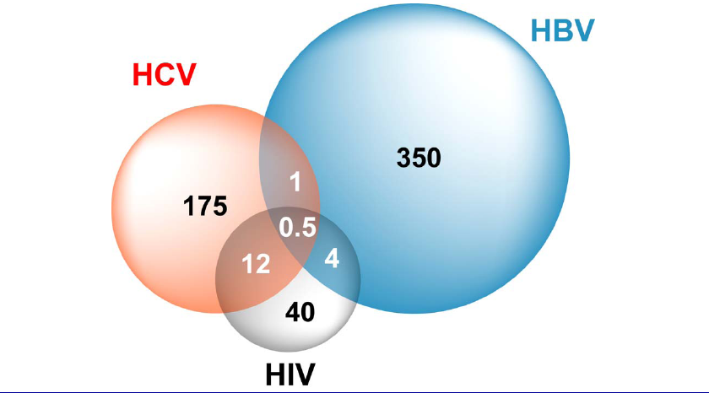
Estimated numbers of Co-infected persons (worldwide)
Canada: 30% HIV+
(est. 12-15,000) co-infected
Notes:
Due to shared routes of transmission, HBV, HCV and HIV epidemics overlap. With respect to HIV-HCV co-infection, the principal route of transmission through parenteral exposure (e.g. injection drug use, blood products, unsterile medical procedures in endemic countries, etc.). In Canada in 2003, it was estimated that approximately, 30% of HIV infected persons is co-infected with HCV. Based on the most recent estimates from the Public Health Agency of Canada in 2010, 65,000 individuals were HIV infected of whom as many as 19, 500 could therefore be co-infected with HCV.

Slide 7
Prevalence of HCV among
HIV seropositives
MSM
Urban Clinic
Prisons
Hemophiliacs*
IDU
Remis R. Health Canada Report, 2001.
Notes:
* Represent Hemophiliacs infected with HIV and HCV from contaminated blood products prior to routine blood screening. The prevalence of these infections has decreased over time as new infections have been eliminated. However, many co-infected hemophiliacs who survived to benefit from HIV therapy now are experiencing the sequelae of advanced liver disease.

Slide 8
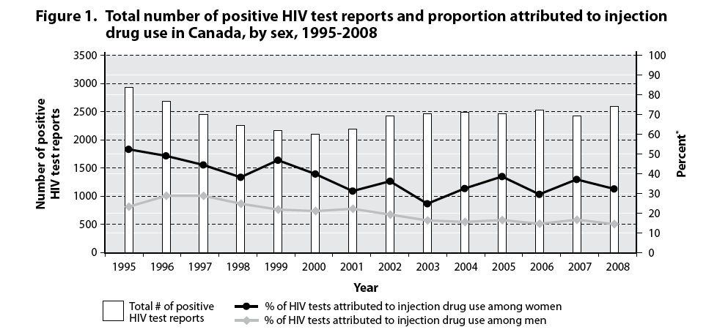
IDU and HIV
Public Health Agency of Canada, 2010
Notes:
IDU accounted for 17.7% of cumulative adult HIV case reports and 8.6% of cumulative adult AIDS cases up to Dec 2008.
Over the last decade, a decreasing trend in the proportion of positive HIV tests attributed to IDU among men; however, an increasing trend among women has been observed since 2003. The 2008 the proportion of new HIV infections attributed to injecting drug use (17%) was slightly higher than the estimate in 2005 (16%).
The reasons for the fall in new HIV infections among injection drug users is likely multi-factorial and include wider testing, better harm reduction practices such as needle exchange, knowledge of safer injection practices, changes in patterns of drug use (e.g. from injection of cocaine to use of crack). Parallel decreases in HCV infection risk in the injection drug use population have also been observed.

Slide 9
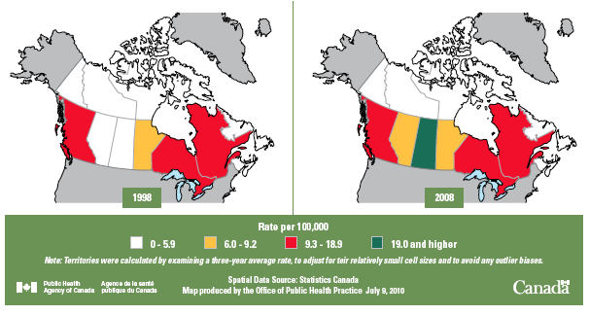
HIV Infection: Recent Trends
Rate (per 100,00 population) of Diagnoses of HIV Infection in Canada, 1998 and 2008 (both sexes, ages >= 15)
Diagnosis of HIV Infection in Canada, 1998 and 2008
Source: ©Statistics Canada & PHAC/Office of Public Health Practice, July 2010
Notes:
As of 2010, Saskatchewan has the highest HIV infection rates in Canada at twice the national average at 20.8 vs. 9.3/100,000.

Slide 10
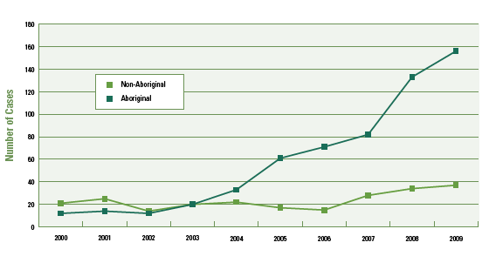
Saskatchewan:
An Emerging Epidemic
HIV Cases by Selected Self-reported Ethnicity in Saskatchewan, 2000 to 2009
Ministry on Health-PHB, 2010
Notes:
Saskatchewan has seen a substantial increase in new cases of HIV since 2003 and 2010. (PHAC, HIV and AIDS in Canada; Surveillance Report, December 31, 2008)
The epidemiology of HIV in Saskatchewan is different from the rest of Canada, with 75% of new HIV cases in 2009 predominantly associated with injection drug use.
Aboriginal women under age 30 account for a disproportionate number of all new HIV-positive cases in the province (Ministry of Health, PHB, 2010).

Slide 11
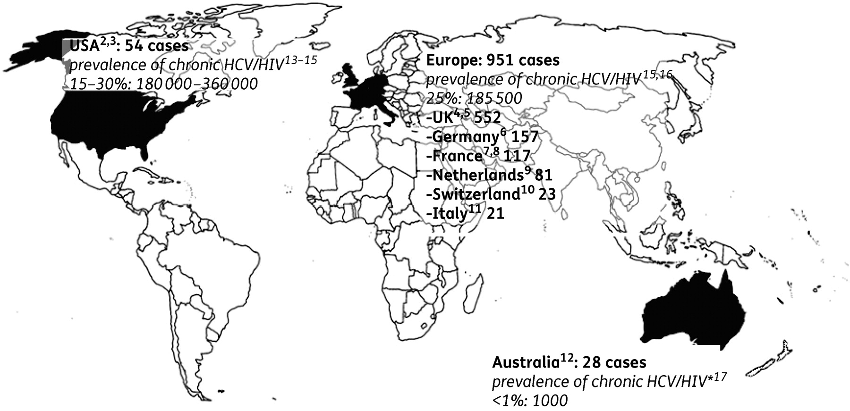
Reported cases of acute HCV infections among HIV-positive men who have sex with men and prevalence of chronic HCV/HIV infection.
Vogel, Rockstroh. J Antimicrob Chemother, 2010
Notes:
Since about 2000, reports of acute HCV infection among HIV-infected and HIV-uninfected men who have sex with men (MSM), with the sole risk factor being sexual exposure have been increasingly reported worldwide.
A recent systematic review reported that HIV-positive MSM are a 4 times higher risk of acquiring HCV compared with HIV-negative MSM (6.08/1000 person-years (95% CI: 5.18 to 6.99) vs. 1.48/1000 person-years (95% CI 0.75 to 2.21) substantiating the need for routine screening initiatives in the HIV+ MSM population. Rates among HIV- MSM were not sufficient to recommend routine screening except on a case by case basis where risk behaviours warrant. (Yaphe et al Sex Transm Infect. 2012 Nov;88(7):558-64)
There have been no official reports on the number of acute HCV infections among HIV+ or HIV negative MSM in Canada, however, many jurisdictions have noted a rise in the number of cases. Overall, cohort studies in MSM suggest the risk of HCV among MSM without IDU exposure is similar to that in the general population.
*No direct estimates on the prevalence of chronic HCV/HIV available; assumption based on the prevalence of HCV among intravenous drug users and the number of acquired HIV infections via injection drug use in Australia.

Slide 12
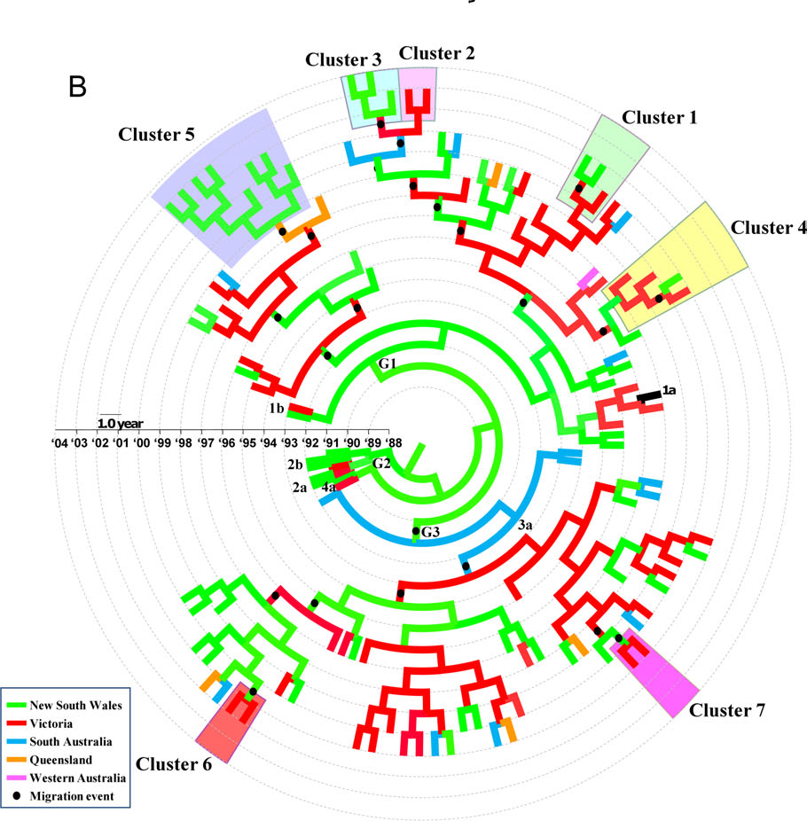
Acute HCV:
Importance of Transmission networks
IDU in 73%
Sexual transmission in 18% of whom 92% were HIV+.
Matthews. Clin Inf Dis, 2011
Notes:
Sequence analyses from HCV strains collected from acutely infected persons in Australia have highlighted the importance of networks in transmission of HCV, particularly for those who were HIV +. Among 112 individuals with available sequences, 23 (20%) were infected with a strain of HCV identical to that of another acute case. The majority of clusters (78%) were HIV infected. In all clusters (except for 1 female HIV-uninfected pair), individuals identified as MSM, irrespective of HIV status.

Slide 13
Increased Risk of Cirrhosis and ESLD in HIV/HCV-Coinfected Patients
A
B
Makis
Eyster
Soto
Telfer
Pol
Makris
Benhamou
Lesens
Combined
Combined
0.76 1.0 2.07 10.83
0.61 1.0 6.14 10 175.32
Relative Risk (95% Cl)
RR of for end-stage liver disease: 2.92 (95% CI, 1.70-5.01).
Graham et al. Clin Infect Dis, 2001

Slide 14
Predicted Future Prevalence of HCV in the United States
4.0%
3.0%
Total Infected
HCC
Cirrhosis
Prevalence of HCV Infection
2.0%
1.0%
0.0%
1960 1970* 1980 1990 2000 2010 2020 2030
Year
Armstrong et al. Hepatology, 2000
Notes:
The peak of HCV infections in the United States occurred in late 1990s and as a consequence of the institution of screening of blood products has steadily fallen after 2000. Reductions in new infection rates among injection drug users has further contributed to a decline in the prevalence of HCV infections. However, chronic HCV is slowly progressive and clinical disease is often unapparent until more than 20 years after infection. Thus the peak in morbidity and mortality from HCV is only just beginning and the prevalence of cirrhosis, end stage liver disease and hepatocellular carcinoma (HCC) are expected to remain high well past 2030.

Slide 15
Projected liver-related outcomes:
Population 242,521
900
Cirrhosis
800
700
Death
600
500
Cases
Decompensation
400
300
HCC
200
100
0
1967
1972
1977
1982
1987
1992
1997
2002
2007
2012
2017
2022
2027
Remis R. Public Health Agency of Canada, 2007
Notes:
15
These graphs project the incidence of hepatitis C complications out to 2027 modeled from Ontario data. Some of the assumptions about rates of progression of disease are likely too low. However, this is the only Canadian data available, and therefore this has been widely quoted, despite its limitations.

Slide 16

Study Setting:
The Canadian Co-infection Cohort
Multi-site prospective cohort of HIV-infected persons with chronic HCV infection or evidence of HCV exposure
Between 2003 and the end of 2012, 1020 persons were enrolled from 16 sites
Participants fill out a questionnaire and provide blood for laboratory analysis
Follow-up visits take place every 6 months
Notes:
The Canadian Co-infection Cohort is a multi-centre prospective cohort of HIV-infected patients with chronic HCV infection or evidence of HCV exposure in care at urban and semi-urban clinics. Recruitment began in 2003 and as of December 2012, 1050 patients have been enrolled from 16 sites across Canada, which are shown on this map.
After providing informed consent, participants undergo an initial evaluation and then follow-up visits take place every 6 months. During each visit, patients complete a questionnaire that collects sociodemographic, medical and behavioural information. In addition, results from routine blood tests like measurements of plasma HIV and HCV RNA, CD4 T cell counts, AST and platelets were extracted from laboratory reports and included in each questionnaire. Treatment history and Medical diagnoses are captured (www.cocostudy.ca) Klein et al, IJE 2009.

Slide 17
Mortality in the Canadian Co-infection Cohort Study
Cause of death | N | %
ESLD | 18 | 29
OVERDOSE | 15 | 24
CANCER | 6 | 10
AIDS | 3 | 5
OTHERS (infections/trauma) | 9 | 15
UNKNOWN | 11 | 18
Total | 62 | 100
SMR: 17.08 (95% CI; 12.83, 21.34)
Klein. HIV Medicine, 2012
Notes:
These results from the Canadian Co-infection Cohort Study show that the majority of deaths among co-infected persons in care are from endstage liver disease (ESLD) and drug overdose. Thus approximately 50% of deaths may have been potentially be preventable through wider access to HCV treatment and improved harm reduction.
Indeed, ESLD has emerged as a primary cause of morbidity and mortality in HIV infected persons² including in Canada³ surpassing HIV-related deaths.

Slide 18
How to reduce burden of HCV in HIV infected persons?
Testing
  Estimates that in US only 30% of chronic HCV are aware of their infection;
  Among HIV infected persons this is probably much lower as routine screening for HCV is recommended
Harm reduction, counselling and services
Safe injection and infection control practices
Need to increase general knowledge among patients and physicians and referral to HCV care and services as HCV is often not prioritized
Treatment
  Clear evidence that successful HCV treatment leads to reduced disease burden (e.g. Reduces rates of cirrhosis, ESLD and HCC)
  ? Treatment as prevention

Slide 19
High Rates among incarcerated Populations
Among those ever tested for HCV, 31% reported being positive
This self-reported rate of HCV infection is approximately 39 times greater than the rate of 0.7% in the Canadian population
Aboriginal women reported the highest rate: 49%, more than 50% greater than the rates among non-Aboriginal women (30%) and all men (30.8%)
% Ever Told they had HIV or HCV
HIV
HCV
Correctional Services 2010 Nº R-211
Notes:
Special populations require consideration. There are extremely prevalence rates of HCV and HIV among inmates incarcerated in federal and provincial institutions particularly among aboriginal persons. New HCV infections continue to occur in incarcerated populations, through both drug use and tattooing. Inmates released back into the community may be unaware of their infection, may be unwilling or unable to access screening and medical care, and may continue to engage in high-risk behaviors upon release. The barrier between correctional institutions and the outside community has been likened to a semipermeable membrane as persons transition into and out of and back into prison repeatedly may be at highest risk. The need for harm reduction and safe injections in prisons is clear. HCV treatment while incarcerated is available on a limited basis but could represent a means impacting rates of HCV both within and outside these institutions.

Slide 20
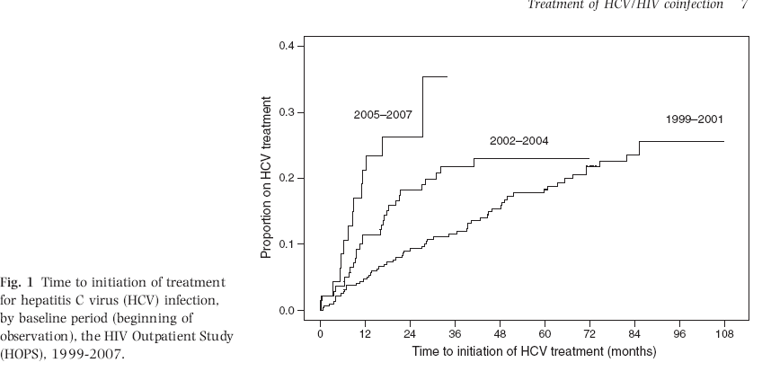
A minority of co-infected patients initiate treatment
US:
Overall only 20% initiate treatment in the HOPS cohort
Canada:
1.1% (15 of 1360) initiated treatment for HCV from January 2000 to December 2004 in a BC inner city cohort (Grebely, J Viral Hepatitis, 2009)
Canadian Co-infection Cohort: 16% already treated at baseline and 13% initiate follow-up (total: 29% in 2010)
Notes:
Although there has been a trend to increasing numbers of co-infected patients initiating HCV treatment in recent calendar years, the majority remains untreated.
Ref: Vellozzi et al. Treatment of hepatitis C virus (HCV) infection in patients coinfected with HIV in the HIV Outpatient Study (HOPS), 1999–2007. J Virol Hepatitis 2011. 18: 316-324.

Slide 21
HIV-HCV Epidemiology: Summary
Co-infection infection occurs worldwide
In Canada, HCV is strongly associated with IDU and the correctional system especially in aboriginals
Newly identified risk among high risk MSM especially HIV+
Looming epidemic of ESLD and liver related death
Reducing the burden of HCV related morbidity and mortality will require enhanced testing, referral for evaluation and HCV treatment initiation
Notes:
21
In summary, HCV is a global problem. In Canada, it is strongly associated with injection drug use and the correctional system, especially in aboriginal populations. Those at risk of contracting HCV should be screened for infection and individuals infected with HCV should be counseled to reduce the risk to themselves and others. The role of treatment in preventing HCV infections remains to be evaluated particularly as newer more effective and simpler therapies become available.

Slide 22
Management of HIV infection in HIV/HCV co-infected patients
Mark Hull, MD, MHSc, FRCPC
Division of AIDS
University of British Columbia

Slide 23
Objectives
Review the effects of antiretroviral therapy (cART) on HCV natural history
ART regimen choice in co-infected patients:
  Risk of hepatotoxicity
  Amelioration of hepatic fibrosis
  Drug-drug interactions with HCV therapy

Slide 24
Introduction
HIV co-infection negatively affects HCV disease progression:
  Decreased rates of spontaneous clearance in those with pre-existing HIV
    ~10% will clear acute infection
  Higher HCV viral loads, regardless of genotype
    Impacts treatment response to pegylated interferon and ribavirin dual combination regimens
Thomas et al. JAMA 2000.
Sherman et al. J Clin Microbiol,1993.

Slide 25
Introduction
HIV co-infection negatively affects HCV disease progression:
Faster progression to cirrhosis in individuals with untreated HIV infection
  Mean estimated interval to cirrhosis as short as 6.9 yrs vs. 23.2 yrs
This translates into higher risk of complications
  Meta-analysis of 8 studies found co-infection had increased risk of 6.14 for decompensated liver disease
Soto et al. J Hepatol, 1997.
Graham et al. CID, 2001.
Notes:
Soto et al performed a cross-sectional analysis of 547 patients (116 HIV-infected) with HCV and compared time to development of biopsy-proven cirrhosis between HIV co-infected vs. HCV mono-infected patients using first blood transfusion or injection drug use debut as baseline for estimated duration of infection. This study was performed between 1989 and 1994 and therefore recruited patients from the pre-cART era.

Slide 26
Introduction
Management of HIV infection requires consideration of :
1. Effects of antiretroviral therapy (ART) on HCV disease progression
  Early initiation of ART may be necessary
2. Optimizing ART regimen selection
  Risk of hepatotoxicity
  Potential effects on fibrosis progression
  Drug-drug interactions with HCV therapeutic agents

Slide 27
Effects of cART on HCV disease progression
Control of HIV viremia may lead to slower rates of fibrosis progression
  Co-infected individuals undergoing liver biopsy with HIV viral load (pVL) >400 copies/mL had faster fibrosis progression rates than those with pVL <400 copies/mL
  Duration of cART-related pVL suppression associated with decreased hepatic fibrosis
Brau et al. J Hepatol, 2006.
Tural et al. J Viral Hepatitis, 2003.
Notes:
Brau et al conducted a retrospective analysis of 656 HCV patients (274 HIV-infected) and determined a fibrosis progression rate as biopsy-determined fibrosis score/duration of HCV infection. Fibrosis progression rates were highest in HIV-infected individuals with detectable HIV pVL (0.151 Ishak fibrosis units/year) but were similarly reduced in HIV-infected individuals with suppressed viral load and in HCV mono-infected patients (0.122 and 0.128 fibrosis units/year respectively) .

Slide 28
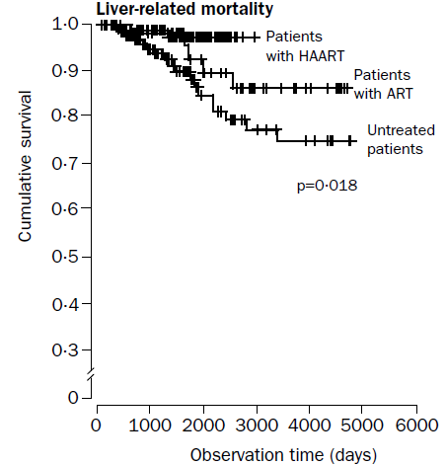

cART decreases HCV liver-related mortality
Bonn cohort (1990-2002)
  285 HIV-HCV co-infected patients
  93 received cART (HAART), 55 dual nucleosides (ART) and 137 received no ARVs
  Liver-related mortality rates per 100 person-years
  cART: 0.45
  Dual therapy: 0.69
  No therapy: 1.70
Qurishi et al. Lancet 2003.

Slide 29
cART decreases liver-related mortality
Prospective cohort of 472 HIV-infected patients
  72 HBV+, 256 HCV+
  8343 patient-months of followup
  41% of overall mortality due to liver-related deaths
Use of 0-2 ART agents vs. cART associated with liver-related mortality (Relative Risk 2.9, 95% CI 1.3 – 6.7)
Multivariate analysis of factors associated
with liver mortality: protective effect of cART
Bonacini et al. AIDS, 2004.
Notes:
In this study 12% of the cohort died from liver-related mortality, and individuals with HIV/HBV/HCV triple infection had higher proportion of deaths (28% vs. 13% and 15%) than HCV and HBV co-infected patients respectively. In Cox regression analysis use of alcohol and initial CD4 cell count <200 were also associated with liver mortality

Slide 30
 | IAS-USA Guidelines 2012 | US DHHS Guidelines 2012 | British HIV Association Guidelines 2012 | European AIDS Clinical Society Guidelines 2012
HCV co-infection | ART regardless of CD4 cell count | ART regardless of CD4 cell count | ART if CD4 < 500 cells/mL | ART if CD4 < 500 cells/mL >500 – consider if HCV therapy not feasible
Grade of evidence | BIIa | BII | IC
Notes:
CART may serve to decrease fibrosis progression and liver-related mortality. Early initiation of cART may therefore potentially reduce HCV morbidity in patients. This concept is reflected in current therapeutic guidelines for the initiation of cART. All guidelines suggest deferring cART in individuals with CD4 >500 cells/ul if HCV therapy is to be initiated to avoid risk of drug-drug interactions
Sources: Thompson M, et al. JAMA 2012; 308:387-402. . DHHS March 27, 2012 guidelines available at http://aidsinfo.nih.gov/guidelines; Williams I, et al. HIV Medicine 2012;13(Suppl 2) 1-85; EACS Guidelines November 2012 available at http://www.europeanaidsclinicalsociety.org/

Slide 31
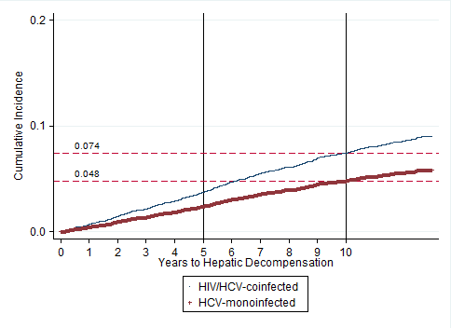
Incidence of Hepatic Decompensation despite cART
ART-Treated
HIV/HCV-Coinfected
Log-rank
p<0.001
HCV-Monoinfected
* Based on competing risk regression analysis.
Lo Re. IAS 2012. Abstract WEAB0102
Notes:
Retrospective cohort study from the US VACS cohort. Overall 6,079 HCV mono-infected and 4,280 HIV/HCV co-infected patients on cART included. The mean age was 47 and 48 years respectively, and 44.9% of co-infected patients had CD4 nadir <200 cells/uL. This data suggests that despite cART risk for hepatic decompensation continues.

Slide 32
Antiretroviral therapy-related hepatotoxicity
Initiation of cART is associated with increased risk of hepatotoxicity in co-infected individuals.
  The incidence of Grade 3 or 4 hepatotoxicity has been estimated to be between 2-18% in observational studies
  Additional risk factors include alcohol or substance use, older age and in some studies genotype 3 HCV
Nunez. Hepatology, 2010.
Nunez et al. JAIDS, 2002.
Notes:
Grade 3 or 4 hepatotoxicity defined as rise in ALT of 5-10 x upper limit of normal range (ULN), and >10 x ULN respectively

Slide 33
Mechanisms of liver toxicity
Figure from Nunez. J Hepatology, 2006.

Slide 34
Antiretroviral therapy-related hepatotoxicity
Most reports of hepatotoxicity originate in the early cART era (1996-2002)
Early protease inhibitors associated with risk of hepatotoxicity
  In particular high-dose ritonavir
Nevirapine > efavirenz
Sulkowski et al. JAMA, 2000.
Aceti et al. JAIDS, 2002.
Sulkowski et al. Hepatology, 2002.
Martin-Carbonero et al. HIV Clin Trials, 2003.
Notes:
Sulkowski et al evaluated hepatoxicity of early cART regimens in a cohort of 298 individuals between 1996-8. Overall 52% were coinfected and 10.4% developed hepatotoxicity. In co-infected patients, incidence of hepatoxicity with PI use was 12.2%, but in regression analysis only use of high dose ritonavir remained associated. This group also assessed NNRTI-related hepatoxicity in co-infected patients. Incidence of nevirapine-related hepatoxicity was 18.1 cases/100 persons exposed (95% CI 4.9 - 46.5) in co-infected patients vs. 6.1 cases (95% CI 1.0 – 21.8) in HIV mono-infected patients. Incidence of efavirenz-related hepatotoxicity was 9.7 cases/100 persons exposed (95% CI 3.6 – 19.9) for co-infected patients vs. 0 cases (95%CI 0 – 4.2) in mono-infected patients.

Slide 35
Antiretroviral therapy-related hepatotoxicity
Successful HCV therapy associated with decreased risk of subsequent ART hepatotoxicity
Cohort of 132 co-infected individuals
33% achieved SVR
Lower yearly incidence of hepatotoxicity in those with SVR (3.1% vs. 12.9%)
Labarga et al. JID, 2007.

Slide 36
Current antiretroviral regimens in co-infected patients
Current first and second line regimens appear well-tolerated in HCV co-infected patients
  Atazanavir/ritonavir
  Raltegravir
  Rilpivirine
  Etravirine
  Darunavir/ritonavir
Absalon et al. J Int AIDS Soc, 2008.
Rockstroh et al. ICAAC, 2012 Abstract 1297.
Nelson et al. JAC, 2012.
Clotet et al. JAC, 2010.
Rachlis et al. HIV Clin Trials, 2007.
Notes:
Post-hoc analyses of the CASTLE (atazanavir) 48 week data, STARTMRK/BENCHMRK (raltegravir) 3-5 year data, ECHO/THRIVE (rilpivirine) week 48 efficacy data, DUET (etravirine) week 48 data, and POWER1,3 week 48 data (darunavir)

Slide 37
cART and HCV therapy
DDI:
  increased risk of mitochondrial toxicity
  Increased risk of hepatic decompensation if cirrhotic
D4T:
  increased risks of mitochondrial toxicity/lactic acidosis while on ribavirin
AZT:
  increased risk of anemia
  Concomitant need for ribavirin dose reduction
  Decreased SVR
Alvarez et al. J Viral Hepatitis, 2006.
Fleischer et al. Clin Infect Dis, 2004.
Bani-Sadr et al. J Infect Dis, 2008.

Slide 38
cART and HCV therapy
Abacavir: ? interaction with ribavirin with lower HCV SVR
  Retrospective review of the RIBAVIC trial: OR 4.92 (95% CI 1.50-16.06) for lower EVR
  Not seen in analyses of SVR in a cohort treated with weight-based dosing
Bani-Sadr et al. JAIDS, 2007.
Laufer et al. Antiviral Therapy, 2008.

Slide 39
cART and HCV PI interactions
ARV | Telaprevir | Boceprevir
Raltegravir | ↔ | ↔
Efavirenz | ↓ Telaprevir AUC Needs dose of 1125mg q8hr | ↓ 20% BOC AUC/Cmin
Atazanavir/r | ↓ 20% TPV AUC ↑17% ATV AUC | ↓35% ATV AUC
Lopinavir/r | ↓54% TPV AUC | ↓45% BOC AUC ↓34% LPV AUC
Darunavir/r | ↓ 35% TPV AUC ↓40% DRV AUC | ↓32% BOC AUC ↓44% DRV AUC
Notes:
Raltegravir has no significant drug interactions when combined with Telaprevir (R. Van Heeswijk, et al. ICAAC 2011. Abstract A1-1738a) or Boceprevir (de Kanter C, et al. CROI 2012. Abstract 772).
Telaprevir: significant reductions in AUC when used with efavirenz, lopinavir-ritonavir Van Heeswijk R, et al. CROI 2011. Abstract 119.
Boceprevir: significant reductions when used with efavirenz and the PI’s Kasserra C, et al. CROI 2011. Abstract 118, Hulskotte E, et al. CROI 2012 Abstract771LB

Slide 40
Novel considerations for cART choice in co-infection
Potential decrease in fibrosis progression with switch from PI to raltegravir
  Ongoing clinical trial
    ClinicalTrials.gov identifier: NCT01231685
Maraviroc may modulate chemokine pathways associated with fibrosis
  Preliminary studies underway
Macias et al. Eur J Clin Microbiol Infect Dis, 2012.
Nasta et al. IAS, 2010 Abstract WEAB0105
Notes:
Macias et al evaluated 24 co-infected individuals who began a maraviroc-containing regimen and evaluated change in transforming growth
factor-β1 (TGF-beta1), matrix metalloproteinase-2 (MMP-2) and tissue inhibitor of matrix metalloproteinase-1 (TIMP-1) were measured in serum samples at baseline and 6 months after starting MVC. No significant changes were noted – with the inference that a lack of change would be unusual in co-infected individuals suggesting an effect of maraviroc.
Nasta et al. evaluated change in liver stiffness score in individuals adding maraviroc to a stable regimen of atazanavir/ritonavir/truvada compared to control arm. 24 individuals were assessed at week 24, with decreased liver stiffness scores noted in those on maraviroc.

Slide 41
Conclusions
Untreated HIV infection is associated with rapid progression of hepatic fibrosis and cirrhosis risk.
Initiating cART may slow progression of hepatic disease
  But increased risk for hepatic disease remains higher than mono-infected patients
Current guidelines support early cART initiation in HIV/HCV patients
  In those with CD4 count >500 strong consideration should be given to HCV therapy prior to cART

Slide 42
Conclusions
cART use may increase risk of hepatoxicity
  Prior successful HCV therapy lowers this risk
Selection of cART regimen should take into account future HCV therapy and risk of drug-drug interactions

Slide 43
Management of HCV in Co-Infected Patients
Marie-Louise Vachon, MD, MSc
Division of Infectious Diseases
Centre Hospitalier Universitaire de Québec

Slide 44
Management of HCV in Co-Infected Patients
Prevention and counselling
Baseline laboratory testing
All patients should be considered for HCV treatment
Treatment recommendations for HCV genotype 1 infection
Monitoring during therapy
Side effect management
Resistance issues

Slide 45
Prevention and Counselling: What patients should be told
Avoid alcohol
Maintain healthy diet and weight
Use precautions to prevent transmission of HCV (and HIV) to others and reinfection
Get vaccinated against hepatitis A virus (HAV) and hepatitis B virus (HBV) if susceptible
Give a complete list of medications, vitamins, supplements and herbs you are currently taking to your doctor

Slide 46
Baseline Laboratory Testing
Virological tests to confirm and type HCV infection
  Anti-HCV
  HCV RNA
  HCV genotype
Baseline blood tests
  CBC with differential
  CD4/CD8 counts
  Liver enzymes and function tests (ALT, AST, ALP, GGT, Tot and direct bili, albumin, INR)
  Glucose and insulin, creatinine
  AFP
Liver Imaging
  Abdominal ultrasound
Liver fibrosis assessment
  FibroScan
  Biomarker panel
  Liver biopsy
Other
  Screen for HBV and HAV immunity
  Tests to exclude other liver disease
  Tests to diagnose extrahepatic manifestations of HCV
  IL28B
Notes:
The baseline complete laboratory testing includes
Confirmation of (chronic) hepatitis C with positive HCV RNA. A qualitative assay can be used to confirm HCV infection. However a quantitative assay has to be used the day hepatitis C treatment starts. HCV genotyping will determine HCV treatment choice and will help to predict response rates. Boceprevir and telaprevir are approved for HCV genotype 1 treatment only. HCV genotype 1b has higher SVR rates with HCV PIs than HCV genotype 1a.
Baseline blood tests include a CBC with differential. A low platelet count suggests (usually cirrhotic) portal hypertension. CD4 absolute and relative count is part of the baseline evaluation of HIV/HCV co-infected patients. There is no threshold under which HCV treatment is not recommended. During HCV treatment, absolute CD4 count decreases while relative CD4 count is usually stable or slightly increases. Anemia has to be characterized (and if possible treated) before HCV treatment, eg iron deficiency anemia, B12 or folate deficiency anemia, and anemia associated with HIV nucleoside analogues, especially zidovudine. Liver enzymes can be normal or elevated with HCV in HIV co-infected patients and are not used to make treatment decisions. The AST/ALT ratio is usually less than 1.0. A ratio above 1,0 suggests alcohol abuse and/or cirrhosis. With fasting glucose and insulin, HOMA-IR can be calculated to assess for insulin resistance which has been associated with lower SVR rates with pegIFN/RBV combination therapy. Its impact on SVR rates with HCV PI use in HIV/HCV co-infected patients has not been evaluated but there was no role in HCV monoinfected patients.
Liver imaging is usually done with abdominal ultrasound. Liver MRI or CT-SCAN better characterize liver morphology, assess signs of portal hypertension and detect HCC.
Liver fibrosis assessment is part of the initial evaluation. In HIV-infected patients, staging of fibrosis with liver biopsy is not mandatory to guide treatment decisions in any HCV genotype and should not be a barrier to HCV treatment.
HBV screening is part of the initial evaulation in every HIV-infected patient. HBsAg positivity impacts HIV and HCV management. Susceptible patients should be offered HBV and HAV vaccination. Other tests can be ordered on a case to case basis as for HCV mono-infected patients. Essential mixed cryoglobulinemia and porphyria cutanea tarda have to be excluded in patients with suggestive skin lesions. IL28B testing can help make treatment decisions. A CC genotype at SNP rs12979860 of IL28B gene is associated with high SVR rates with pegIFN and RBV. If the use of a HCV PI is not desirable (eg. DDIs), dual therapy may be considered in these patients.

Slide 47
FibroScan® and serum biomarkers for fibrosis assessment
FibroScan ® (transient elastography)
  Health Canada-approved
  Non-invasive
  Fast
  Can be done during first patient’s visit
  High sensitivity to exclude cirrhosis
  Validated in HIV/HCV co-infected patients
Serum biomarkers
  APRI
  FIB-4
  Forns index
  others
Liver biopsy is helpful when there is discordant or indeterminate results with
non-invasive techniques and to diagnose other causes of liver disease.
Notes:
Available data suggest that FibroScan® is a helpful tool for guiding therapeutic decisions in HIV/HCV co-infected patients. In a study of 100 co-infected patients, 3 cut-off values were chosen to identify F ≤ 1 (<7 kPa), F ≥ 3 (≥11 kPa) and F4 (≥14 kPa), based on receiver operating characteristic (ROC) curves. With these cut-off scores, the negative predictive value and positive predictive value were 81.1% and 70.2% for the diagnosis of F ≤ 1, 96.3% and 60% for the diagnosis of F ≥ 3 and 100% and 57.1% for the diagnosis of F4. (Sanchez-Conde M. et al. J Viral Hepat. 2010) Thus, FibroScan correctly excluded cirrhosis in all patients. FibroScan and serum biomarkers have lower performance in intermediate stages of liver fibrosis. In most studies, serum biomarkers have lower sensitivities to detect fibrosis and cirrhosis compared with liver biopsy. They are best used in combination with other tests of liver fibrosis. APRI, FIB4 and Forns index are the panels that have been most widely studied in co-infected patients.

Slide 48
All patients with HIV/HCV co-infection should be considered for HCV therapy
HCV PI in association with pegIFN and RBV has been approved for treatment of genotype 1 HCV mono-infection
Safety and efficacy in HIV-infected patients are largely unproven and regulatory approval is pending, but preliminary data are encouraging
  Decisions to use or withhold HCV PIs in HIV/HCV co-infected persons depend on multiple considerations
Contraindications to pegIFN and RBV therapy apply with the use of HCV PI

Slide 49
Considerations prior to decision to use or withold HCV treatment
  HCV eradication is associated with decreased morbidity and mortality
    Liver fibrosis progresses more rapidly in HIV co-infected patients
    Priority is given to patients with advanced fibrosis and cirrhosis
  Higher success rates are achieved in patients with positive predictors of SVR
    Consider treating patients with IL28B CC genotype, low viral load (<400 000 IU/ml), naïve or prior relapsers, even if no or low fibrosis stage
  Patient’s motivation
    Now may be a good time to treat for some patients (e.g. young woman with mild fibrosis who wishes to become pregnant in the future)
  Well-controlled HIV is desired before starting HCV treatment
    Patients with well-controlled HIV respond better to HCV treatment and higher CD4 counts facilitate management during HCV treatment. For patients with low CD4 counts (<200 cells/mm³), if possible, ART should be initiated and HCV treatment delayed until HIV RNA is undetectable and CD4 counts have increased
  Drug-drug interactions between HCV PIs and ART should be assessed: overall limited data available
  Liver transplantation is not widely available and not highly successful in HIV co-infected
  Poor side effect profile associated with HCV PIs and new anti-HCV drugs are being developed
Notes:
In HIV/HCV co-infected patients, there is every reason to treat HCV of all genotypes including those with compensated (Child’s A) cirrhosis. Patients who are willing to start therapy and who do not have contraindications to pegIFN and RBV should be encouraged to undergo treatment. SVR reduces liver-related morbidity and mortality in HIV/HCV co-infected patients. The indication for HCV treatment is clear in those with stage 2/4 and above on the METAVIR fibrosis scale. When fibrosis is stage 0 or 1 and the decision is made to not undergo treatment, regular patient follow-up every 3-6 months and repeat fibrosis assessment is recommended at 3-year intervals.

Slide 50
Treatment Options for HCV Genotype 1 Patients co-infected with HIV: DHHS Guidelines
Recommendations on use of boceprevir or telaprevir in HIV/HCV genotype 1 co-infected patients
Patient Group | Recommendation*
Patients not on ART | Use either boceprevir or telaprevir
Patients receiving RAL + 2 NRTIs | Use either boceprevir or telaprevir
Patients receiving ATV/r + 2 NRTIs | Use telaprevir at the standard dose. Do not use boceprevir.
Patients receiving EFV + 2 NRTIs | Use telaprevir at increased dose of 1,125 mg every 7-9 hours. Do not use boceprevir.
*These recommendations may be modified as new drug interaction and clinical trial information become available.
DHHS Guidelines, 2012.
Notes:
At the time this slide deck is written, both telaprevir and boceprevir, recently approved HCV protease inhibitors, have not yet been approved by Health Canada for use in patients with HIV/HCV co-infection. However, available data demonstrate safety and improved SVR rates with the addition of a HCV PI, and consequently the US Department of Health and Human Services (DHHS) has updated its guidelines to recommend use of PIs in HIV/HCV co-infection. We agree with these guidelines with a few additional specifications:
1- Although HCV co-infection is an indication to start HIV treatment, patients with high CD4 cell counts (>500 cells/mm³) who are not on ART may initiate HCV treatment with pegIFN + RBV and either of HCV PI boceprevir or telaprevir.
2- Patients receiving 2 NRTIs and raltegravir (RAL) may start on pegIFN + RBV and either of HCV PI boceprevir or telaprevir. The 2 NRTIs tenofovir DF and emtricitabine have been most widely studied. See drug-drug interactions chapter.
3- Boceprevir use is not recommended in patients with atazanavir/ritonavir because of significant decreased atazanavir/ritonavir levels and possibility of HIV viral breakthrough. However boceprevir levels are unchanged with this combination thus its use could be considered on a case to case basis.

Slide 51
Proposed treatment algorithm: telaprevir in patients with HIV/HCV co-infection
Until more data are available, a 48 week treatment duration is recommended for all HIV infected patients using week 4, 12 and 24 futility rule time points, without RGT.
Undetectable HCV RNA
End of treatment
Telaprevir +
Peg-IFN/RBV
Peg-IFN/RBV
PEG-IFN/RBV
Week
0
4*
8*
12*
Week 24*
Week 48
Peg-IFN : peginterferon; RBV : ribavirine; RGT: response-guided therapy
* Stop treatment at these timepoints because of futility in patients with HCV RNA > 1000 IU/mL at week 4 or 12 or a detectable HCV RNA at week 24.
Notes:
This is the proposed treatment algorithm using telaprevir in all patients (naïve and prior treatment failures) with HIV/HCV co-infection until more data become available. Efficacy data of telaprevir in HIV/HCV co-infected patients at the time this is written come from a phase 2b clinical trial that used telaprevir in combination with pegIFN/RBV for the first 12 weeks followed by pegIFN and RBV for an additional 36 weeks, thus a 48 week treatment duration in all naïve patients. RGT was not used in this trial although is is being evaluated in another clinical trial. Data are also awaited for previously-treated co-infected patients.
Telaprevir duration is 12 weeks, in combination with pegIFN and RBV.
HCV RNA is quantified at baseline, at week 4, week 8 and week 12. A futility rule is met if HCV RNA is measured > 1000 IU/ml at week 4, 8, or 12.
HCV RNA is measured (qualitative or quantitative assay) at week 24. A futility rule is met if HCV RNA is detectable (any level of HCV RNA).
HCV RNA is measured at week 48, and at 1,3, and 6 months post treatment to assess SVR.
Est-ce nécessaire puisqu`’on traite
tous les cirrhotiques de la même façon

Slide 52
Proposed treatment algorithm: boceprevir in patients with HIV/HCV co-infection
Until more data are available, a 48 week treatment duration is recommended for all HIV infected patients using week 12 and 24 futility rule time points, without RGT.
Add boceprevir at end of week 4
HCV RNA undetectable
End of treatment
Peg-IFN
RBV
PEG-IFN/RBV
Boceprevir + Peg-IFN/RBV
Week
0
4
8
12*
Week 24*
Week 48
Peg-IFN : peginterferon; RBV : ribavirine; RGT: response-guided therapy
* Stop treatment at these time points because of futility in patients with HCV RNA >100 IU/ml at week 12 or a detectable HCV RNA at week 24.
Notes:
This is the proposed treatment algorithm using boceprevir in all patients (naïve and prior treatment failures) with HIV/HCV co-infection until more data become available. Efficacy data of boceprevir in HIV/HCV co-infected patients at the time this is written come from a phase 2b clinical trial that used a lead-in of pegIFN and RBV for 4 weeks followed by boceprevir in combination with pegIFN/RBV for the following 44 weeks, thus a 48 week treatment duration in all naïve patients. RGT was not used in this trial although is is being evaluated in another clinical trial. Data are also awaited for previously-treated co-infected patients.
Boceprevir is always given following a 4-week lead-in with pegIFN and RBV.
Boceprevir duration is 44 weeks, in combination with pegIFN and RBV.
HCV RNA is quantified at baseline, and at week 12. A futility rule is met if HCV RNA is measured ≥ 100 IU/ml at week 12.
(In the phase 2b trial that used boceprevir in combination with pegIFN and RBV, the futility rule at week 12 was a less than 2 log10 decrease in HCV RNA)
HCV RNA is measured (qualitative or quantitative assay) at week 24. A futility rule is met if HCV RNA is detectable (any level of HCV RNA).
HCV RNA is measured at week 48, and at 1,3, and 6 months post treatment to assess SVR.
On recommande de mesurer le taux d’ARN du VHC aux semaines 8, 12 et 24, ainsi qu’à la fin du traitement, pendant la période de suivi et à tout autre moment où la détermination du taux d’ARN du VHC est cliniquement indiquée.
Comme sur la diapo précédante
Comme sur la diapo précédante

Slide 53
Monitoring during HCV treatment
What to monitor
When to monitor
HCV RNA, quantitative
HCV RNA, qualitative
Other laboratory tests
  CBC with differential, liver panel, biochemistry, TSH, CD4 cell count, HIV viral load, and AFP if cirrhotic
Telaprevir: Week 0,4,8, and 12
  Boceprevir: Week 0 and 12
  Telaprevir: Week 24 and 48
  Boceprevir: Week 24 and 48
  CBC weekly for the first 4 weeks of PI use, every other week until week 12 and every month thereafter. Use clinical judgement. Liver panel, CD4 count, . biochemistry and TSH monthly.
  HIV load every 4-12 weeks, AFP every 6 months if cirrhotic.
Notes:
Laboratory monitoring during HCV treatment can be challenging with the use of HCV PIs. Since futility rules have specific viral load thresholds over which therapy has to be stopped, it is important to obtain quantitative HCV RNA at these specific time points. After week 12, qualitative or quantitative assays can be used. HCV RNA testing can be done at other time points during treatment according to clinical judgement if viral breakthrough is suspected.
One of the most frequent adverse event expected with HCV triple therapy is anemia. Anemia can develop rapidly and be severe, especially in patients with cirrhosis. Weekly (to every other week according to judgement) CBC is therefore recommended for the first 4 weeks of PI use. CD4 cell count and HIV viral load should be monitored regularly during treatment. HIV viral breakthrough has been reported with the use of boceprevir. Patients with cirrhosis should continue HCC screening during HCV treatment. Thus, AFP and abdominal ultrasound every 6 months should be included in the tests performed during HCV treatment.

Slide 54
Testing during HCV treatment with telaprevir of HIV co-infected patients
Week Test | 0 | 1-3 | 4 | 6 | 8 | 10 | 12 | 16 | 20 | 24 | 28-44 | 48
HCV RNA quant | X |  | X |  |  |  | X
HCV RNA qual |  |  |  |  |  |  |  |  |  | X |  | X
CBC | X | X | X | X | X | X | X | X | X | X | X | X
CD4+ | X |  | X |  | X |  | X |  |  | X | 36 | X
HIV RNA | X |  | X |  |  |  | X |  |  | X | 36 | X
Liver + bio | X |  | X |  | X |  | X | X | X | X | X | X
TSH | X |  | X |  | X |  | X | X | X | X | X | X
AFP | X |  |  |  |  |  |  |  |  | X |  | X

Slide 55
Testing during HCV treatment with boceprevir of HIV co-infected patients
Week Test | 0 | 2 | 4 | 5-7 | 8 | 10 | 12 | 16 | 20 | 24 | 28-44 | 48
HCV RNA quant | X |  |  |  |  |  | X
HCV RNA qual |  |  |  |  |  |  |  |  |  | X |  | X
CBC | X | X | X | X | X | X | X | X | X | X | X | X
CD4+ | X |  | X |  | X |  | X |  |  | X | 36 | X
HIV RNA | X |  | X |  |  |  | X |  |  | X | 36 | X
Liver + bio | X |  | X |  | X |  | X | X | X | X | X | X
TSH | X |  | X |  | X |  | X | X | X | X | X | X
AFP | X |  |  |  |  |  |  |  |  | X |  | X

Slide 56
Side effect management
The most frequent adverse events reported in the clinical trials are
  Telaprevir: Rash, pruritus, anemia and ano-rectal discomfort
  Boceprevir: Anemia and dysgueusia
Same side effect management in co-infected as in HCV mono-infected
  Anemia can be severe and develop rapidly
  Ribavirin dose reduction in HCV mono-infection does not impact SVR rates
Notes:
Among HCV mono-infected patients treated with HCV PI in combination with pegIFN and RBV, ribavirin dose reduction to manage anemia has been shown to be safe and does not reduce SVR rates. This had been demonstrated in a prospective trial using boceprevir in combination with pegIFN and RBV and in a retrospective analysis in patients using telaprevir. It is currently unknown if ribavirin dose reduction in HIV/HCV co-infected patients impacts SVR rates with the use of HCV PIs.

Slide 57
HCV Protease Inhibitors and resistance
Higher HCV viral load in HIV/HCV co-infected patients suggests higher risk for resistance development
Patient adherence to q7-9 hours schedule of boceprevir and telaprevir
Strict adherence to futility rules
Boceprevir and telaprevir have the same resistance pattern. Patients who fail HCV PI therapy should not be retreated with the same or the other protease inhibitor
Not every patient needs to be treated right away: treatment can be deferred in those with no or mild fibrosis or unmotivated patients
  Other anti-HCV treatment classes are being evaluated in clinical trials that will be active against PI failures
Notes:
Higher HCV viral load in HIV/HCV co-infected patients suggests higher risk for HCV resistance development. Preliminary data from the two phase IIb studies of telaprevir and boceprevir do not show higher HCV viral breakthrough rates. In the telaprevir study, 3 patients receiving telaprevir experienced HCV RNA breakthrough: 2 patients on efavirenz and 1 patient on atazanavir. In the boceprevir trial,
(HIV breakthroughs were observed in 3/64 patients in the BOC group and 4/34 patients in the control group and in none of the patients receiving telaprevir)

Slide 58
Summary: Management of HCV in co-infected patients
Baseline blood, imaging and fibrosis assessment is important to characterize HCV infection and plan HCV treatment
PegIFN/RBV combination has low efficacy but SVR significantly increases outcomes
Hepatitis C protease inhibitors in combination
with PegIFN/RBV increase SVR
  Phase II and III trials under way
  Significant drug-drug interactions with ART

Slide 59
HCV Therapy:
Direct Acting Antiviral Agents in Co-Infected Individuals
Curtis Cooper, MD, FRCPC
Faculty of Medicine, Division of Infectious Diseases
University of Ottawa

Slide 60
Key Peg-Interferon and Ribavirin Studies in HIV-HCV Co-Infection
APRICOT (Dietrich et al.)
    95 centers, 19 countries (Canada 33 patients)
    Academic based
RIBAVIC (Perrone et al.)
    ANRS (French National Study Group)
    Community based
ACTG 5071 (Chung et al.)
    US Cooperative group
    21 US community based sites
Notes:
The initial 3 key Peg-Interferon and Ribavirin co-infection studies
Important to note low RBV dosing used

Slide 61
APRICOT (Dietrich)
  IFN alfa-2a + ribavirin 800 mg/daily
3MIU TIW (48 wks)
  N=285
Screening
PEG IFN alfa-2a + Placebo
180 μg QW (48 wks)
  N=286
PEG IFN alfa-2a + ribavirin 800 mg/daily
180 μg QW (48 wks)
  N=289
  N=511
Endpoint
24 weeks
Follow-up
48 weeks
Primary endpoint: loss of serum HCV-RNA 24 weeks post-treatment.
Notes:
9
Lecture notes
After screening, patients were randomized to 1 of 3 study arms¹:
The control group received interferon alfa-2b (3MU) as a flat dose, whereas the ribavirin was dosed according to body weight (1000-1200 mg.).
In the 1.5 µg/kg peginterferon/ribavirin arm, peginterferon alfa-2b was dosed according to body weight, but ribavirin was administered at a fixed dose (800 mg).
In the lower-dose arm (peginterferon 1.5 + 0.5 µg/kg), both peginterferon alfa-2b and ribavirin were dosed according to body weight.
The rationale for the peginterferon doses selected in the lower-dose arm (1.5 µg/kg for 4 weeks + 0.5 µg/kg for 44 weeks) was that: (1) the highest HCV RNA clearance rates at 4 weeks were produced by 1.5 µg/kg in the peginterferon monotherapy study (Schering-Plough Research Institute, data on file), and (2) 0.5 µg/kg was anticipated to have equivalent or better activity to interferon monotherapy. Standard doses of ribavirin were used in this treatment arm.
The rationale for investigating 1.5 µg/kg peginterferon alfa-2b with 800 mg/d ribavirin in the higher-dose arm was that: (1) 1.5 µg/kg provided the highest ETVR in the peginterferon alfa-2b monotherapy study², particularly for genotype 1, and (2) there was concern that standard doses of ribavirin might result in more anemia when combined with 1.5 µg/kg peginterferon.
After completion of treatment (48 weeks) there was a 24-week follow-up period. Liver biopsies were conducted at baseline and after the 24-week follow-up.
References
1. Manns MP, McHutchison JG, Gordon S, et al. Peginterferon alfa-2b plus ribavirin compared to interferon alfa-2b plus
ribavirin for the treatment of chronic hepatitis C: 24-week treatment analysis of a multicenter, multinational phase III
randomized controlled trial [abstract 552]. Hepatology. 2000;32:297A.
2. Trepo C, Lindsay K, Niederau C, et al. Pegylated interferon alfa-2b (PEG-INTRON) monotherapy is superior to
interferon alfa-2b (INTRON A) for the treatment of chronic hepatitis C [abstract GS2/08]. J Hepatol. 2000;32
(suppl 2):29.

Slide 62
Virologic Response* – End of Treatment vs End of Follow-up (Genotype 1)
End of treatment
SVR
% Response
* Defined as <50 IU/mL HCV RNA
Notes:
Shown here are the virologic responses for G1 patients at the end of treatment and end of follow up.
SVR was 29% for G1, the highest ever observed in coinfection
Relapse rates in this trial were low and ….

Slide 63
Virologic Response* – End of Treatment vs End of Follow-up (Genotype 2 and 3)
End of treatment
SVR
% Response
* Defined as <50 IU/mL HCV RNA
Notes:
Relapse rates were even lower in G2 and 3.
With 48 weeks of peg ifn and ribavirin, the SVR was 62% for g2/3

Slide 64
Withdrawal from Treatment
% of Patients
Notes:
I will now go on to present the safety results.
Overall withdrawals from treatment in apricot were much lower than expected in coinfection
Withdrawals due to Lab abnormalities were 0-5%….
Withdrawals due to adverse events were 12 to 14%…
Of note, the high rate of withdrawal for non-safety reason of 24% in the conventional arm was mainly due to lack of response on treatment

Slide 65
RIBAVIC:
ITT SVR Genotype 1

Slide 66
RIBAVIC: Safety
Treatment Discontinuation:
 | IFN + RBV | PEG + RBV
Discontinuation | 35% (n=72) | 38% (n=77)
SAE:
 | IFN + RBV | PEG + RBV
SAE | 31% (n=64) | 31% (n=63)
Notes:
As with Apricot, the discontinuation rate was high and SAE profile challenging
Similar disappointing efficacy results with ACTG Study

Slide 67
Improved Outcomes with Increased Ribavirin Dosing
Peginterferon α-2b vs. Interferon α-2b
+ Ribavirin 800 – 1200 mg/d
HCV-genotype 1 or 4 HCV-genotype 2 or 3
EOT: p=0.033
SVR: p=0.007
EOT: p=0.914
SVR: p=0.730
Laguno et al. AIDS, 2004.

Slide 68
Can Outcomes be Improved with the Addition of Protease Inhibitors and Other Direct Acting Antivirals?
capsid
envelope
protein
Protease / Helicase
RNA-dependent RNA Polymerase
c22
33c
c-100
5’
3’
core
E1
E2
NS2
NS3
NS4
NS5a / NS5b
hypervariable
region
Notes:
7
7
7

Slide 69
Boceprevir and Telaprevir
Approved and funded HCV protease inhibitors for HCV genotype 1 mono-infection based on substantial improvement in SVR for treatment naïve, relapses, partial responders and null responders
Used in combination with peginterferon alfa-2/ ribavirin
Key Phase III HCV-Mono-Infection Studies
Boceprevir
  SPRINT-2: naive GT1 patients
  RESPOND-2: nonresponder GT1 patients
Telaprevir
  ADVANCE: naive GT1 patients
  ILLUMINATE: response-guided therapy in naive GT1 patients
Notes:
There are currently 2 HCV protease inhibitors that are approved and funding in Canada
Only approved for genotype 1 use

Slide 70
Boceprevir Plus Peginterferon/Ribavirin for the Treatment of HCV/HIV Co-Infected Patients
Weeks 12 24 28 48 72
PEG2b
+RBV
4 wk
Placebo + PEG2b + RBV
44 wk
Follow-up
SVR-24 wk
Arm 1
PEG2b
+RBV
4 wk
Boceprevir + PEG2b + RBV
44 wk
Follow-up
SVR-24 wk
Arm 2
Futility Rules
Two-arm study, double-blinded for BOC, open-label for PEG2b/RBV
  2:1 randomization (experimental: control)
  Boceprevir dose 800 mg TID
4-week lead-in with PEG2b/RBV for all patients
  PEG-2b 1.5 µg/kg QW; RBV 600-1400 mg/day divided BID
Control arm patients with HCV-RNA ≥ LLOQ at TW 24 were offered open-label PEG2b/RBV+BOC via a crossover arm
CROI 2012- Abstract # Q-175

Slide 71
Demographics and Baseline Characteristics
 | PR (N=34) | B/PR (N=64)
Age (years), mean (SD) | 45 (9.8) | 43 (8.3)
Male, n (%) | 22 (65) | 46 (72)
Race, n (%)
White Non-white | 28 (82) 6 (18) | 52 (81) 12 (19)
Body mass index, mean (SD) | 26 (4) | 25 (4)
Cirrhosis, n (%) | 1 (3) | 4 (6)
HCV genotype subtype, n (%)*
1a 1b | 22 (65) 10 (29) | 42 (66) 15 (23)
HCV RNA level >800,000 IU/mL, n (%) | 30 (88) | 56 (88)
HIV RNA <50 copies/mL, n (%) | 33 (97) | 62 (97)
CD4 count (cells/mm³), median (range) | 586 (187-1258) | 577 (230-1539)
*Subtyping not reported for 9 patients with Genotype 1.
CROI 2012- Abstract # Q-175

Slide 72
Virologic Response Over Time
% HCV RNA Undetectable
Updated from Sulkowski. Lancet ID. 2013 Jul;13(7):597-605.

Slide 73
Most Common Adverse Events With a Difference of ≥10% Between Groups
 | PR (N=34) | B/PR (N=64)
Anemia | 26% | 41%
Pyrexia | 21% | 36%
Asthenia | 24% | 34%
Decreased appetite | 18% | 34%
Diarrhea | 18% | 28%
Dysgeusia | 15% | 28%
Vomiting | 15% | 28%
Flu-like illness | 38% | 25%
Neutropenia | 6% | 19%
CROI 2012- Abstract # Q-175

Slide 74
Analysis Summary
HCV-HIV co-infected HCV treatment naïve patients had high rates of HCV response on BOC
  SVR-24: 62.5% of patients on B/PR vs. 29.4% of patients on PR
Preliminary safety data of B/PR in co-infected patients showed a profile consistent with that observed in mono-infected patients
Updated from Sulkowski. Lancet ID. 2013 Jul;13(7):597-605.

Slide 75
Telaprevir in Combination with Peginterferon
Alfa-2a/Ribavirin in HCV/HIV Co-infected Patients:
SVR24 Analysis
Part A: no ART
T/PR
TVR + PR
PR
SVR12
SVR
Follow-up
1:1
PR48
(control)
Pbo + PR
PR
SVR12
SVR
Follow-up
Part B: ART (EFV/TDF/FTC or ATV/r + TDF + FTC or 3TC)
T/PR
TVR + PR
PR
SVR12
SVR
Follow-up
2:1
PR48
(control)
Pbo + PR
PR
SVR12
SVR
Follow-up
Weeks
0
12
24
36
48
60
72
(EFV)=efavirenz; (TDF)=tenofovir; (FTC)=emtricitabine; (ATV/r)=ritonavir-boosted atazanavir; (3TC)=lamivudine;
(T) TVR=telaprevir 750 mg q8h or 1125 mg q8h (with EFV); Pbo=Placebo; (P) Peg-IFN=pegylated interferon alfa-2a (40 kD) 180 µg/wk; (R) RBV=ribavirin 800 mg/day or weight-based (1000 mg/day if weight <75 kg, 1200 mg/day for if weight ≥75 kg; France, Germany, n=5 patients)
Roche COBAS® TaqMan® HCV test v2.0, LLOQ of 25 IU/mL, LOD of <10 IU/mL
Updated from CROI 2012

Slide 76
Patient Demographics and Baseline Characteristics
 | Part A |  | Part B
 | No ART |  | EFV/TDF/FTC |  | ATV/r + TDF + FTC or 3TC
 | T/PR N=7 | PR N=6 | T/PR N=16 | PR N=8 | T/PR N=15 | PR N=8
Gender, n (%): Male | 6 (86) | 4 (67) | 16 (100) | 7 (88) | 13 (87) | 7 (88)
Caucasian†, n(%) Black/African American, n(%) | 2 (29) 4 (57) | 3 (50) 3 (50) | 12 (75) 3 (19) | 5 (62) 3 (38) | 13 (87) 2 (13) | 7 (88) 1 (12)
Ethnicity†: Hispanic, n (%) | 3 (43) | 2 (33) | 5 (31) | 1 (12) | 3 (21) | 3 (38)
Age, median years (range) | 39 (34-50) | 48 (42-65) | 48 (31-57) | 47 (31-53) | 52 (36-59) | 39 (26-53)
BMI, median kg/m² (range) | 29 (22-37) | 31 (26-37) | 24 (21-32) | 23 (19-28) | 24 (23-33) | 25 (22-30)
HCV RNA ≥ 800,000 IU/mL**, n (%) | 7 (100) | 5 (83) | 13 (81) | 7 (88) | 12 (80) | 7 (88)
HCV Genotype Subtype*, n (%) 1a 1b Other | 3 (43) 4 (57) 0 (0) | 3 (50) 2 (33) 1 (17) | 12 (75) 4 (25) 0 (0) | 6 (75) 1 (12) 1 (12) | 12 (80) 3 (20) 0 (0) | 5 (62) 3 (38) 0 (0)
Bridging Fibrosis, n(%) Cirrhosis, n (%) | 1 (14) 0 (0) | 0 (0) 0 (0) | 2 (12) 2 (12) | 1 (12) 0 (0) | 0 (0) 0 (0) | 1 (12) 0 (0)
HIV RNA median copies/mL (range) | 1495 (193-53,450) | 267 (25-21,950) | 25 (25-25) | 25 (25-25) | 25 (25-25) | 25 (25-25)
CD4+ median cells/mm³ (range) | 604 (496-759) | 672 (518-1189) | 533 (299-984) | 514 (323-1034) | 514 (254-874) | 535 (302-772)
†Race and ethnicity were self-reported *5’NC InnoLipa line probe assay
**Roche COBAS® TaqMan® HCV test v2.0, LLOQ of 25 IU/mL and LLOD of 10-15 IU/mL
CROI 2012

Slide 77
SVR Rates 24 Weeks Post-Treatment (SVR24*)
100
90
80
80
74
71
69
70
60
Patients with SVR (%)
50
50
45
50
40
33
30
20
10
0
n/N =
5/7
11/16
12/15
28/38
2/6
4/8
4/8
10/22
T/PR
PR
No ART
EFV/TDF/FTC
ATV/r/TDF/FTC
Total
*Patient was defined as SVR24 if HCV RNA was < LLOQ in the visit window
Updated from Sulkowski. Ann Intern Med. 2013 Jul 16;159(2):86-96.

Slide 78
Events of Special Interest: Overall Treatment Phase
 | T/PR N=38 n (%) | PR N=22 n/N (%)
Severe rash | 0 (0) | 0 (0)
Mild and moderate rash | 13 (34) | 5 (23)
Anemia | 7 (18) | 4 (18)
Grade 3 hemoglobin shifts* (7.0-8.9 g/dL) | 11 (29) | 5 (23)
Use of erythropoietin stimulating agent | 3 (8) | 1 (5)
Blood transfusions | 4 (11) | 1 (5)
CD4 counts declined in both T/PR and PR groups; CD4% remained unchanged
*DAIDS HIV-negative scale
CROI 2012

Slide 79
Conclusions
Higher SVR24 rates were observed in chronic genotype 1 HCV/HIV co-infected patients treated with telaprevir combination treatment
  T/PR 74%
  PR 45%
In patients treated with telaprevir combination treatment, overall safety and tolerability profile was comparable to that previously observed in chronic genotype 1 HCV mono-infected patients
Updated from Sulkowski. Ann Intern Med. 2013 Jul 16;159(2):86-96.

Slide 80
Interactions Between HCV and HIV PIs
Summary of Healthy Volunteer Studies
Dosing recommendations:
  Boceprevir: coadministration with ritonavir-boosted PIs is not recommended
  Telaprevir: do not administer with DRVr, FPVr or LPVr; ongoing evaluation with ATVr
van Heeswijk et al. CROI 2011, #119. Hulskotte et al. CROI 2012, #771LB
Notes:
DDI interactions are a major issue to consider in DAA recipients; especially in ARV treated HIV co-infected patients
Switching to a HIV intergrase inhibitor prior to starting HCV antiviral therapy is a consideration
Important to note that no clinically significant DDI with HCV protease inhibitors were noted in either the boceprevir (atazanavir/r, darunavir/r, lopinavir/r allowed) or telaprevir (atazanavir/r allowed) Phase 2 studies

Slide 81
Interactions Between HCV DAA & EFV
Summary of Healthy Volunteer Studies
Dosing recommendations:
  Boceprevir: co-administration EFV is not recommended
  Telaprevir: use 1125 mg TID with EFV
van Heeswijk et al. CROI 2011, #119. Garg et al. 6th HCV PK Wksp 2011, #PK_13. Victrelis Monograph 2011
Notes:
DDI interactions are a major issue to consider in DAA recipients; especially in ARV treated HIV co-infected patients

Slide 82
Statement
The addition of DAA to IFN-based HCV antiviral therapy produces a substantial improvement in SVR with minimal increased sides effects
Development of other Direct Acting Antivirals holds promise for additional advances in HIV-HCV co-infection treatment

Slide 83
Drug Interactions with Directly Acting Antivirals for HCV
Overview and Challenges in
HIV/HCV Co-Infection
Alice Tseng, Pharm.D., FCSHP, AAHIVP
Toronto General Hospital
Faculty of Pharmacy
University of Toronto

Slide 84
Outline
Understand how the pharmacology of DAAs contribute to drug interactions
Highlight important HCV drug interactions
Outline a strategy for identifying and managing drug interactions
Identify pertinent HCV drug interaction resources

Slide 85
Boceprevir and Telaprevir Pharmacology
 | Boceprevir | Telaprevir
Dosing | 800 mg q8h with food | 750 mg q8h with food (20 g fat)
Substrate | CYP3A4, P-gp, AKR | CYP3A4, Pgp
Inhibitor | 3A4, P-gp | 3A4, P-gp, renal transporters (?)
Inducer | No inducing effects in vitro (in vivo?)
potential for interactions with other drugs
  can be clinically significant
  sometimes unpredictable
Notes:
85
Boceprevir and telaprevir are substrates and inhibitors of CYP3A4. Boceprevir is also metabolized via aldoketoreductases, but this appears to be a minor pathway.
Both agents also inhibit p-glycoprotein and telaprevir may inhibit renal transporters. Boceprevir and telaprevir have not demonstrated enzyme inducing activity in vitro.
Maintaining adequate plasma concentrations is important for directly acting antiviral agents. These drugs have short half-lives, and thus must be taken at regular (every 8 hours) dosing, with the proper amount of food in order to be adequately absorbed. Use of other agents which inhibit or induce CYP3A4 and/or p-glycoprotein can result in altered plasma concentrations of DAAs.
Many phase 3 HCV agents are also substrates of CYP450, P-gp, and/or other transporters, and may possess inhibiting or inducing properties.
Therefore, there is a high potential for interactions between current and future directly acting antiviral agents and other drug classes.
These interactions may be clinically significant, complex, and sometimes unpredictable.

Slide 86
Interactions Between
HCV & HIV Medications
Multiple challenges in treating HIV/HCV co-infected patients
Additive toxicities:
  anemia: ribavirin, zidovudine, DAAs
  CNS effects: interferon, efavirenz
Altered concentrations of ARVs and/or DAAs:
  ↑ risk of toxicity
  ↓ efficacy, potential development of resistance (HIV and/or HCV)
Notes:
86
Boceprevir and telaprevir are substrates and inhibitors of CYP3A4. Both agents also inhibit p-glycoprotein and telaprevir may inhibit renal transporters. Similarly, HIV protease inhibitors and non-nucleoside reverse transcriptase inhibitors are substrates and inhibitors or inducers of numerous CYP450 hepatic enzymes and transporters. The CCR5 inhibitor maraviroc is a CYP3A4 substrate but does not exert inhibiting or inducing effects on the P450 system. Therefore, there is a high potential for drug interactions in the co-infected population, particularly if simultaneous treatment of HCV and HIV is required.
Both antiretrovirals and current HCV treatment have multiple adverse effects, and coadministration can lead to pharmacodynamic interactions. For example, didanosine, stavudine, and zidovudine should be avoided with pegylated interferon and ribavirin because of increased risks of mitochondrial toxicity and anemia. Some controversy exists whether concomitant abacavir may be associated with a reduced response to pegylated interferon and ribavirin, but a recent in vitro study showed that the anti-HCV activity of ribavirin was not modified by abacavir. It is important to achieve adequate ribavirin trough levels via weight-based dosing, and there is insufficient evidence to recommend avoiding this combination. Ribavirin may cause a decrease in the total lymphocyte count, which can affect CD4 cell counts. Therefore, the CD4 percentage, rather than the absolute number, may be a more appropriate measure of immunologic efficacy during ribavirin treatment. Another example is the combination of pegylated interferon and efavirenz, where additive CNS effects including depression, mood changes, and suicidality, may occur.
Pharmacokinetic interactions between directly acting agents and antiretrovirals can result in negative impact on concentrations of DAAs and/or antiretrovirals. Interactions between DAAs and antiretrovirals may limit cART treatment choices, which may be particularly challenging in HIV-treatment experienced patients. If dose modifications are required, such changes may be associated with significant increases in cost. There is also the potential for underdosing of antiretrovirals and/or DAAs, which may lead to treatment failure and development of resistance of either HIV or HCV. Given the fact that there may be cross-resistance between not only current but also future DAAs in development, current as well as future HCV treatment options may be compromised.
References:
Tseng A, Foisy M. Important drug-drug interactions in HIV-infected persons on antiretroviral therapy: an update on new interactions between HIV and non-HIV drugs. Curr Infect Dis Report 2012; 14(1):67-82.
Kiser JJ, Burton JR, Anderson PL, Everson GT. Review and management of drug interactions with boceprevir and telaprevir. Hepatology 2012;55:1620-8.

Slide 87
Telaprevir 750 mg q8h plus Boosted PIs in Healthy Volunteers
Telaprevir exposure ↓ with PI/r
  AUC ↓ 20-54%
  Cmin ↓ 15-52%
van Heeswijk et al. CROI 2011, #119
Notes:
In healthy volunteers, the coadministration of telaprevir and boosted protease inhibitors resulted in significant reductions in telaprevir exposures.
Telaprevir exposures were reduced 20-54% in the presence of boosted HIV PIs. Atazanavir/ritonavir had the smallest impact on telaprevir concentrations, so this boosted PI is ongoing further study in combination with telaprevir.
van Heeswijk R, Vandevoorde A, Boogaerts G, et al. Pharmacokinetic Interactions between ARV Agents and the Investigational HCV Protease Inhibitor TVR in Healthy Volunteers [abstract 119]. 18th Conference on Retroviruses and Opportunistic Infections, February 27-March 2, 2011, Boston, MA.
Background: Atazanavir/ritonavir (ATV/r), darunavir/r (DRV/r), fosamprenavir/r (fAPV/r), and lopinavir/r (LPV/r) are substrates and inhibitors of CYP3A. Efavirenz (EFV) is an inducer of CYP3A. Telaprevir (TVR) is a substrate and inhibitor of CYP3A. In previous trials with TVR 750 mg every 8 hours, TVR Cmin was reduced by 47% by EFV and tenofovir AUC24h was increased by 30% by TVR. Interactions between TVR and antiretroviral (ARV) agents were evaluated to guide studies of TVR in HIV/hepatitis C virus (HCV) co-infected patients.
Methods: Three separate open-label, randomized cross-over trials were conducted in HIV/HCV– healthy volunteers. In 2 studies, volunteers received 2 treatments; TVR 750 mg every 8 hours for 10 days, followed by a washout and ATV/r 300/100 mg once daily, DRV/r 600/100 mg twice daily, fAPV/r 700/100 mg twice daily, or LPV/r 400/100 mg twice daily (n = 20 each) for 20 days with co-administration of TVR 750 mg every 8 hours from day 11 onwards, or vice versa. All compounds were taken with food. In another study, 20 volunteers started TVR 750 mg every 8 hours for 7 days followed by EFV/tenofovir disoproxil fumarate (TDF) 600/300 mg once daily for 7 days after a washout. Subsequently, volunteers received TVR 1125 mg every 8 hours and EFV/TDF 600/300 mg once daily for 7 days or TVR 1500 mg every 12 hours and EFV/TDF 600/300 mg once daily for 7 days in a randomized order without a washout. TVR was taken with food and EFV/TDF was taken on an empty stomach in the morning. Least square means (LSMeans) and 90%CI of treatment ratios (test/reference) were calculated for the log-transformed AUCtau and Cmin
Results: The LSMeans ratios (90%CI) are shown below. TVR doseARVTVR AUCtauTVR CminARV AUCtauARV CminTVR 750 mg every 8 hoursATV/r0.80 (0.76 to 0.85)0.85 (0.75 to 0.98)1.17 (0.97 to 1.43)1.85 (1.40 to 2.44)DRV/r0.65 (0.61 to 0.69)0.68 (0.63 to 0.74)0.60 (0.57 to 0.63 )0.58 (0.52 to 0.63)fAPV/r0.68 (0.63 to 0.72)0.70 (0.64 to 0.77)0.53 (0.49 to 0.58)0.44 (0.40 to 0.50)LPV/r0.46 (0.41 to 0.52)0.48 (0.40 to 0.56)1.06 (0.96 to 1.17)1.14 (0.96 to 1.36)TVR 1125 mg every 8 hoursEFV0.82 (0.73 to 0.92)0.75 (0.66 to 0.86)0.82 (0.74 to 0.90)0.90 (0.81 to 1.01)TDF1.10 (1.03 to 1.18)1.17 (1.06 to 1.28)TVR 1500 mg every 12 hoursEFV0.80 (0.73 to 0.88)0.52 (0.42 to 0.64)0.85 (0.79 to 0.91)0.89 (0.82 to 0.96)TDF1.10 (1.03 to 1.17)1.06 (0.98 to 1.15)
Conclusions: Interactions were observed between TVR and ritonavir-boosted protease inhibitors; appropriate doses have not been established. A higher dose of TVR (1125 mg every 8 hours) could partly offset the interaction with EFV. TVR 750 mg every 8 hours with ATV/r, and TVR 1125 mg every 8 hours with EFV are being evaluated in an ongoing study in HIV/HCV co-infected individuals.

Slide 88
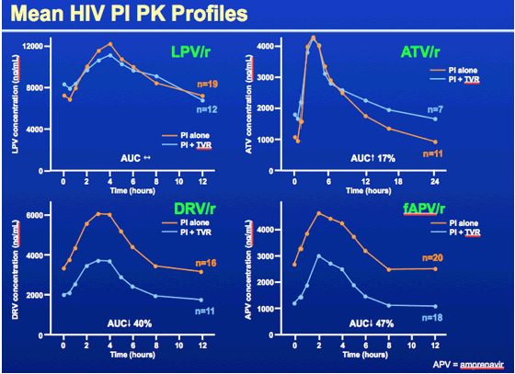
Telaprevir 750 mg q8h plus Boosted PIs in Healthy Volunteers
Telaprevir had variable effect on PIs:
  40-47% ↓ AUC of DRVr, FPVr
  n/c with ATVr, LPVr
Appropriate doses not yet established
van Heeswijk et al. CROI 2011, #119
Notes:
In healthy volunteers, coadministration of telaprevir and boosted protease inhibitors also resulted in significant reductions in exposures of darunavir/ritonavir and fosamprenavir/ritonavir. Appropriate doses have not yet been established, and coadministration with telaprevir is not recommended. The combination of telaprevir and atazanavir/ritonavir is being evaluated in an ongoing study.
van Heeswijk R, Vandevoorde A, Boogaerts G, et al. Pharmacokinetic Interactions between ARV Agents and the Investigational HCV Protease Inhibitor TVR in Healthy Volunteers [abstract 119]. 18th Conference on Retroviruses and Opportunistic Infections, February 27-March 2, 2011, Boston, MA.
Background: Atazanavir/ritonavir (ATV/r), darunavir/r (DRV/r), fosamprenavir/r (fAPV/r), and lopinavir/r (LPV/r) are substrates and inhibitors of CYP3A. Efavirenz (EFV) is an inducer of CYP3A. Telaprevir (TVR) is a substrate and inhibitor of CYP3A. In previous trials with TVR 750 mg every 8 hours, TVR Cmin was reduced by 47% by EFV and tenofovir AUC24h was increased by 30% by TVR. Interactions between TVR and antiretroviral (ARV) agents were evaluated to guide studies of TVR in HIV/hepatitis C virus (HCV) co-infected patients.
Methods: Three separate open-label, randomized cross-over trials were conducted in HIV/HCV– healthy volunteers. In 2 studies, volunteers received 2 treatments; TVR 750 mg every 8 hours for 10 days, followed by a washout and ATV/r 300/100 mg once daily, DRV/r 600/100 mg twice daily, fAPV/r 700/100 mg twice daily, or LPV/r 400/100 mg twice daily (n = 20 each) for 20 days with co-administration of TVR 750 mg every 8 hours from day 11 onwards, or vice versa. All compounds were taken with food. In another study, 20 volunteers started TVR 750 mg every 8 hours for 7 days followed by EFV/tenofovir disoproxil fumarate (TDF) 600/300 mg once daily for 7 days after a washout. Subsequently, volunteers received TVR 1125 mg every 8 hours and EFV/TDF 600/300 mg once daily for 7 days or TVR 1500 mg every 12 hours and EFV/TDF 600/300 mg once daily for 7 days in a randomized order without a washout. TVR was taken with food and EFV/TDF was taken on an empty stomach in the morning. Least square means (LSMeans) and 90%CI of treatment ratios (test/reference) were calculated for the log-transformed AUCtau and Cmin
Results: The LSMeans ratios (90%CI) are shown below. TVR doseARVTVR AUCtauTVR CminARV AUCtauARV CminTVR 750 mg every 8 hoursATV/r0.80 (0.76 to 0.85)0.85 (0.75 to 0.98)1.17 (0.97 to 1.43)1.85 (1.40 to 2.44)DRV/r0.65 (0.61 to 0.69)0.68 (0.63 to 0.74)0.60 (0.57 to 0.63 )0.58 (0.52 to 0.63)fAPV/r0.68 (0.63 to 0.72)0.70 (0.64 to 0.77)0.53 (0.49 to 0.58)0.44 (0.40 to 0.50)LPV/r0.46 (0.41 to 0.52)0.48 (0.40 to 0.56)1.06 (0.96 to 1.17)1.14 (0.96 to 1.36)TVR 1125 mg every 8 hoursEFV0.82 (0.73 to 0.92)0.75 (0.66 to 0.86)0.82 (0.74 to 0.90)0.90 (0.81 to 1.01)TDF1.10 (1.03 to 1.18)1.17 (1.06 to 1.28)TVR 1500 mg every 12 hoursEFV0.80 (0.73 to 0.88)0.52 (0.42 to 0.64)0.85 (0.79 to 0.91)0.89 (0.82 to 0.96)TDF1.10 (1.03 to 1.17)1.06 (0.98 to 1.15)
Conclusions: Interactions were observed between TVR and ritonavir-boosted protease inhibitors; appropriate doses have not been established. A higher dose of TVR (1125 mg every 8 hours) could partly offset the interaction with EFV. TVR 750 mg every 8 hours with ATV/r, and TVR 1125 mg every 8 hours with EFV are being evaluated in an ongoing study in HIV/HCV co-infected individuals.

Slide 89
Two-Way Interaction between Boceprevir and Boosted PIs
Interaction studies in healthy volunteers
Coadministration of boceprevir and ritonavir-boosted PIs is not recommended
 | PI Kinetics |  |  | RTV AUC | BOC AUC
 | Ctrough | AUC | Cmax
ATVr | ↓ 49% | ↓ 35% | ↓ 25% | ↓ 34% | -
DRVr | ↓ 59% | ↓ 44% | ↓ 36% | ↓ 27% | ↓ 32%
LPVr | ↓ 43% | ↓ 34% | ↓ 30% | ↓ 22% | ↓ 45%
Hulskotte et al. CROI 2012, #771LB
Notes:
In healthy volunteers, coadministration of boceprevir and boosted protease inhibitors also resulted in negative two-way interactions.
Exposures of the HIV protease inhibitors were significantly reduced, with 34-44% reductions in AUC and 43-59% reductions in trough concentrations in the presence of boceprevir. Furthermore, boceprevir concentrations were reduced 32-45% in the presence of ritonavir-boosted darunavir or lopinavir.
The results of this study led to the issuing of a Dear Health Care Professional letter from Merck USA in February 2012 with a caution about the use of boceprevir and ritonavir-boosted HIV protease inhibitors. The boceprevir monograph was later modified to advise that coadministration of boceprevir and ritonavir-boosted protease inhibitors is not recommended.
Hulskotte EGJ, Feng H-P, Xuan F, et al. Pharmacokinetic interaction between the HCV protease inhibitor boceprevir and ritonavir-boosted HIV-1 protease inhibitors atazanavir, lopinavir, and darunavir [abstract 771LB]. 19th Conference on Retroviruses and Opportunistic Infections, March 5-8, 2012, Seattle, WA.
Background: Boceprevir (BOC) is a potent ketoamide inhibitor of the hepatitis C virus (HCV) NS3 protease that has demonstrated antiviral activity in combination with peg-interferon and ribavirin. HCV co-infection is common among HIV-infected patients and may require co-administration of BOC and ARV drugs. Atazanavir (ATV), lopinavir (LPV), and darunavir (DRV) are among the most frequently prescribed HIV protease inhibitors (HIV-PI). All are given in combination with low-dose ritonavir (r), a potent CYP3A4 inhibitor, which serves as a pharmacokinetic booster. This study was conducted to evaluate the pharmacokinetic interaction of BOC with ATV/r, LPV/r, and DRV/r.
Methods: This was a single-center, 3-part, open-label, drug-interaction study in 39 healthy adult subjects. Subjects received BOC (800 mg three times a day) on days 1 to 6. After a 4-day washout, subjects received ATV/r (300/100 mg every day), LPV/r (400/100 mg twice a day), or DRV/r (600/100 mg twice a day) on days 10 to 31. Subjects received concomitant BOC (800 mg three times a day) on days 25 to 31. Blood samples were collected for the pharmacokinetic assessment of HIV-PI, ritonavir, and BOC. Safety assessments included ECG, vital signs, clinical laboratory tests, physical examination, and adverse event monitoring.
Results: Co administration of BOC with the HIV-PI/r was generally well tolerated. There were no serious adverse events. Concomitant BOC treatment decreased the exposure of all 3 HIV-PI with AUC0-last, Cmax, and Cmin GMR (90% CI) of ATV 0.65 (0.55 to 0.78), 0.75 (0.64 to 0.88), and 0.51 (0.44 to 0.61); of LPV 0.66 (0.60 to 0.72), 0.70 (0.65 to 0.77), and 0.57 (0.49 to 0.65); and of DRV 0.56 (0.51 to 0.61), 0.64 (0.58 to 0.71), and 0.41 (0.38 to 0.45), respectively. Co-administration with BOC also decreased the exposure of ritonavir in all 3 HIV-PI groups, with ritonavir AUCt decreasing 34%, 22%, and 27% in the ATV, LPV, and DRV cohorts, respectively. Co-administration with ATV/r did not alter BOC AUCt, but co-administration with LPV/r and DRV/r decreased BOC AUCt 45% and 32%, respectively.
Conclusions: Concomitant administration of BOC and ATV/r, LPV/r, and DRV/r resulted in reduced steady-state exposures of the HIV-PI, ritonavir, and BOC.

Slide 90
Interactions Between HCV DAA & NNRTIs
Summary of Healthy Volunteer Studies
Dosing recommendations on using HIV non-nucleoside reverse transcriptase inhibitors (NNRTIs) with HCV directly acting antivirals:
  Efavirenz: avoid with boceprevir, use 1125 mg TID telaprevir
  Etravirine: ? with boceprevir, OK with telaprevir
  Rilpivirine: OK with telaprevir
van Heeswijk et al. CROI 2011, #119. Garg et al. 6th HCV PK Wksp 2011, #PK_13.
Victrelis Monograph 2011. Hammond et al. IWCPHT 2012 O-15. Kakuda et al. IWCPHT 2012 O_18
Notes:
90
HIV non-nucleoside reverse transcriptase inhibitors (NNRTIs) are substrates as well as mild-to-moderate inducers of CYP3A4. Therefore, the potential exists for negative interactions with HCV DAAs. These interactions are summarized below.
1) Efavirenz
Boceprevir. Coadministration of boceprevir and efavirenz in healthy volunteers resulted in a 44% decrease in boceprevir trough concentrations and a 19% reduction in overall boceprevir exposures, while efavirenz AUC was increased 20%, compared to either drug administered alone.[1] As such, the product monograph recommends that this combination be avoided.[2]
Telaprevir. In healthy volunteers, multiple-dose administration of efavirenz 600 mg daily and telaprevir 750 mg q8h resulted in 9% decrease in Cmax, 47% decrease in Cmin and 26% decrease in AUC of telaprevir.[3] In a subsequent study, 20 volunteers started telaprevir 750 mg every 8 hours for 7 days followed by efavirenz and tenofovir at standard doses for 7 days after a washout. Subsequently, volunteers received either telaprevir 1125 mg every 8 hours plus efavirenz and tenofovir or telaprevir 1500 mg every 12 hours plus efavirenz and tenofovir for 7 days. Telaprevir was taken with food while efavirenz and tenofovir were taken on an empty stomach in the morning. With the combination of telaprevir 1500 mg every 12 hours plus efavirenz and tenofovir, telaprevir AUC and Cmin decreased by 20% and 48%, respectively, efavirenz AUC and Cmin decreased by 15% and 11%, respectively, and tenofovir AUC and Cmin increased by 10% and 6%, respectively. When telaprevir was dosed at 1125 mg every 8 hours with efavirenz and tenofovir, smaller reductions in telaprevir exposures were observed (AUC decreased 18% and Cmin decreased 25%). This higher dose of telaprevir may partly offset the interaction with efavirenz, and is being evaluated in an ongoing study in HIV/HCV co-infected individuals.[4] However, higher telaprevir doses would be associated with increased acquisition costs.
Etravirine
a)Boceprevir. In healthy volunteers, coadministration of boceprevir 800 mg q8h with etravirine 200 mg BID for 11-14 days resulted in 23% decrease in AUC, 24% decrease in Cmax and 29% decrease in Cmin of etravirine and 10% increase in AUC and Cmax and 12% decrease in Cmin of boceprevir compared to either drug administered alone. The impact on boceprevir concentrations is not considered clinically relevant; however, the impact on etravirine concentrations could be clinically significant.[5]
b)Telaprevir. In healthy volunteers, coadministration of telaprevir 750 mg TID with etravirine 200 mg BID for 11 days resulted in 6% decrease in AUC, 7% decrease in Cmax and 3% decrease in Cmin of etravirine and 16% decrease in AUC, 10% decrease in Cmax and 25% decrease in Cmin of telaprevir compared to either drug administered alone. These changes are not considered clinically relevant, combination may be given without dose adjustment.[6]
3) Rilpivirine
a) Telaprevir. In healthy volunteers, coadministration of telaprevir 750 mg TID with rilpivirine 25 mg daily for 11 days resulted in 78% increase in AUC, 49% increase in Cmax and 93% increase Cmin of rilpivirine and 8% decrease in AUC, 5% decrease in Cmax and 13% decrease in Cmin of telaprevir compared to either drug administered alone. These changes are not considered clinically relevant, combination may be given without dose adjustment.[6] It may be prudent to avoid using combination in patients at increased risk for Torsade de Pointes, or who are on other drugs that may ↑ rilpivirine levels or that are known to cause QTc prolongation.
As such, these interactions between DAAs and antiretrovirals may limit cART treatment choices, which may be particularly challenging in HIV-treatment experienced patients. If dose modifications are required, such changes may be associated with significant increases in cost. There is also the potential for underdosing of antiretrovirals and/or DAAs, which may lead to treatment failure and development of resistance. Whenever possible, non-essential medications should be discontinued for the duration of HCV treatment.
References:
Kasserra C, Hughes E, Treitel M, et al. Clinical pharmacology of boceprevir: metabolism, excretion, and drug-drug interactions [abstract 118]. 18th Conference on Retroviruses and Opportunistic Infections, Feb 27-Mar 2, 2011, Boston, USA.
Merck Canada Inc. VictrelisTM. Product Monograph. Kirkland, Quebec, Canada, June 13, 2012.
3. Garg V, Chandorkar G, Yang Y, et al. The effect of CYP3A inhibitors and inducers on the pharmacokinetics of telaprevir [abstract PK_13]. 6th International Workshop on Clinical Pharmacology of Hepatitis Therapy, June 22-23, 2011, Cambridge, MA
4. Van Heeswijk RPG, Vandevoorde A, Boogaerts G, et al. Pharmacokinetic interactions between ARV agents and the investigational HCV protease inhibitor TVR in healthy volunteers [abstract 119]. 18th Conference on Retroviruses and Opportunistic Infections, Feb 27-Mar 2, 2011, Boston, USA.
5. Hammond K, Wolfe P, Burton J, et al. Pharmacokinetic interaction between boceprevir and etravirine in HIV/HCV seronegative volunteers [abstract O_15]. 13th International Workshop on Clinical Pharmacology of HIV Therapy, April 16-18, 2012, Barcelona, Spain.
6. Kakuda TN, Leopold L, Nijs S, et al. Pharmacokinetic interaction between etravirine or rilpivirine and telaprevir: a randomised, two-way crossover trial [abstract O_18]. 13th International Workshop on Clinical Pharmacology of HIV Therapy, April 16-18, 2012, Barcelona, Spain.

Slide 91
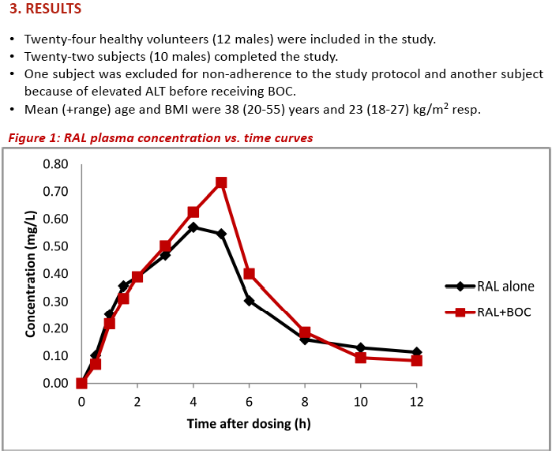
No Clinically Significant Interaction with Raltegravir and Boceprevir or Telaprevir
Mean Raltegravir PK +/- Boceprevir
Mean Raltegravir PK +/- Telaprevir
with TVR:
RAL 78% ↑ Cmin, 26% ↑ Cmax, 31% ↑ AUC
Mean Telaprevir PK +/- RAL
In the presence of raltegravir, boceprevir exposures were similar to historical controls
de Kanter et al. CROI 2012, #772LB.
van Heeswijk et al. ICAAC 2011, #A1-1738a.
Notes:
The integrase inhibitor raltegravir is not a CYP450 substrate, inducer, or inhibitor, and thus may be suitable for inclusion in a patient’s regimen when trying to minimize interactions with other drug classes. Raltegravir may be used with both telaprevir and boceprevir without dosage adjustment. A summary of the pharmacokinetic interaction studies is presented below.
a) Telaprevir plus raltegravir:
In an open-label cross-over study in healthy volunteers, subjects received RAL 400 mg BID or TVR 750 mg q8h alone or in combination for 6 days with food. Telaprevir pharmacokinetics were not altered by raltegravir.
In the presence of telaprevir, raltegravir exposures were increased: 78% ↑ Cmin, 26% ↑ Cmax, 31% ↑ AUC. The mechanism of this interaction is unknown, but may possibly be due to inhibition of intestinal Pgp by telaprevir.
This interaction is not considered clinically relevant; no dose adjustment is required.
Boceprevir plus raltegravir:
In an open-label, randomized, cross-over study, 24 healthy volunteers, received boceprevir 800 mg TID for 10 days plus single dose raltegravir 400 mg on day 10 followed by a wash-out period and single-dose raltegravir 400 mg on day 38, or the same medications in reverse order. Raltegravir exposures were not altered in the presence of boceprevir. The combination may be used without dosage adjustment.
It should be noted that in contrast, the new integrase inhibitor elvitegravir, which was recently licensed in the U.S. as Stribild, a single-tablet regimen, is co-formulated with cobicistat, a pharmacokinetic booster. Cobicistat inhibits CYP3A4 and thus, the potential exists for interactions with DAAs. As such, results from pharmacokinetic interaction studies between raltegravir and DAAs cannot be extrapolated to elvitegravir/cobicistat.
References:
Van Heeswijk RPG, Garg V, Boogaerts G, et al. The pharmacokinetic interaction between telaprevir and raltegravir in healthy volunteers [abstract A1-1738a]. 51st Interscience Conference on Antimicrobial Agents and Chemotherapy, September 17-20, 2011, Chicago, IL.
de Kanter C, Blonk M, Colbers A, et al. The influence of the HCV protease inhibitor boceprevir on the pharmacokinetics of the HIV integrase Inhibitor raltegravir [abstract 772LB]. 19th Conference on Retroviruses and Opportunistic Infections March 5-8, 2012, Seattle, WA.
Mathias AA, West S, Hui J, Kearney BP. Dose-response of ritonavir on hepatic CYP3A activity and elvitegravir oral exposure. Clin Pharmacol Ther 2009; 85: 64–70.

Slide 92
Antiretroviral Treatment Options in HCV
 | Boceprevir | Telaprevir
PIs | Avoid with PIr | Avoid DRVr, FPVr, LPVr
 | Possible ATVr???? | ATVr OK
 | Avoid EFV | Dose ↑ with EFV
NNRTIs | Etravirine (?) | Etravirine OK
 | No data | Rilpivirine OK
InSTIs | Raltegravir OK
 | Elvitegravir/cobicistat: no data (???)
Maraviroc | No data potential ↓/↑ MVC; potential benefit on fibrosis?
NRTIs | Tenofovir OK
 | Avoid AZT (anemia)
Notes:
This table summarizes potential and demonstrated pharmacokinetic interactions between ARVs and DAAs.
Negative two-way interactions have been observed between both boceprevir and telaprevir and ritonavir-boosted protease inhibitors, with significant reductions in exposures of HCV agents and HIV protease inhibitors. Therefore, telaprevir should not be coadministered with ritonavir-boosted darunavir, fosamprenavir, or lopinavir,[1] and boceprevir is not recommended for use with boosted atazanavir, darunavir or lopinavir.[2]
With NNRTIs, telaprevir may be used at a higher dose with efavirenz,[3] and without dosage adjustment with etravirine or rilpivirine.[4] In contrast, boceprevir concentrations are significantly reduced in the presence of efavirenz, and this combination should be avoided.[5] Recent data indicate etravirine concentrations are reduced in the presence of boceprevir; the clinical significance of this effect is unknown, and formal recommendations on coadministration are currently lacking.[6]
Raltegravir is not a P450 substrate, inducer or inhibitor, and may be used with both HCV agents without dosage adjustment.[7,8]
Elvitegravir is a new integrase inhibitor which is co-formulated with cobicistat, a pharmacokinetic booster. Cobicistat inhibits CYP3A4 and thus, the potential exists for interactions with DAAs.
Tenofovir is eliminated renally; in healthy volunteer studies, tenofovir Cmax was increased in the presence of boceprevir[9] and tenofovir AUC was increased in the presence of telaprevir.[10] These changes are not considered to be clinically relevant, and tenofovir may be coadministered with both boceprevir and telaprevir.
References:
1. Vertex Pharmaceuticals Inc. Incivek (telaprevir) Product Monograph. Laval, Quebec, Canada, August 11, 2011.
Hulskotte EGJ, Feng H-P, Xuan F, et al. Pharmacokinetic interaction between the HCV protease inhibitor boceprevir and ritonavir-boosted HIV-1 protease inhibitors atazanavir, lopinavir, and darunavir [abstract 771LB] 19th Conference on Retroviruses and Opportunistic Infections, March 5-8, 2012, Seattle, WA.
Van Heeswijk RPG, Vandevoorde A, Boogaerts G, et al. Pharmacokinetic interactions between ARV agents and the investigational HCV protease inhibitor TVR in healthy volunteers [abstract 119]. 18th Conference on Retroviruses and Opportunistic Infections, Feb 27-Mar 2, 2011, Boston, USA.
Kakuda TN, Leopold L, Nijs S, et al. Pharmacokinetic interaction between etravirine or rilpivirine and telaprevir: a randomised, two-way crossover trial [abstract O_18]. 13th International Workshop on Clinical Pharmacology of HIV Therapy, April 16-18, 2012, Barcelona, Spain.
Merck Canada Inc. Victrelis (boceprevir) Product Monograph. Kirkland, Quebec, Canada, June 13, 2012.
Hammond K, Wolfe P, Burton J, et al. Pharmacokinetic interaction between boceprevir and etravirine in HIV/HCV seronegative volunteers [abstract O_15]. 13th International Workshop on Clinical Pharmacology of HIV Therapy, April 16-18, 2012, Barcelona, Spain.
de Kanter C, Blonk M, Colbers A, et al. The influence of the HCV protease inhibitor boceprevir on the pharmacokinetics of the HIV integrase Inhibitor raltegravir [abstract 772LB]. 19th Conference on Retroviruses and Opportunistic Infections March 5-8, 2012, Seattle, WA.
Van Heeswijk RPG, Garg V, Boogaerts G, et al. The pharmacokinetic interaction between telaprevir and raltegravir in healthy volunteers [abstract A1-1738a]. 51st Interscience Conference on Antimicrobial Agents and Chemotherapy, September 17-20, 2011, Chicago, IL.
Kasserra C, Hughes E, Treitel M, et al. Clinical pharmacology of boceprevir: metabolism, excretion, and drug-drug interactions [abstract 118]. 18th Conference on Retroviruses and Opportunistic Infections, Feb 27-Mar 2, 2011, Boston, USA.
Van Heeswijk R, Gysen V, Googaerts G, et al. The pharmacokinetic interaction between tenofovir disoproxil fumarate and the investigational HCV protease inhibitor telaprevir [abstract A-966]. 48th Interscience Conference on Antimicrobial Agents and Chemotherapy, October 25-28, 2008, Washington, DC.

Slide 93
DAA Interactions with
Other Drug Classes
Antidepressants
Methadone
Benzodiazepines
Cardiovascular Drugs
Transplant Drugs

Slide 94
Treatment of Depression in HCV
Patients with HCV may require antidepressant therapy
Escitalopram is considered a first-line option
  no interaction with boceprevir
  35% ↓ AUC with telaprevir, may need to titrate dose
Agents which are partially metabolized via CYP3A4 may theoretically be ↑ by DAAs
  e.g., desvenlafaxine, venlafaxine, sertraline, mirtazapine, imiprimine
  combinations not studied, clinical significance unknown
Low risk of interactions predicted with bupropion, tricyclic antidepressants, some SSRIs
Notes:
Patients with HCV may require antidepressant therapy. Escitalopram is an effective antidepressant in HCV[1] and has been studied with both boceprevir and telaprevir.
In healthy volunteers, the kinetics of single dose escitalopram 10 mg were not altered to a clinically significant manner in the presence of multiple dose boceprevir 800 mg TID. The pharmacokinetics of boceprevir were similar with and without coadministration of escitalopram. No dosage adjustment is expected to be required with coadministration of this combination.[2]
In healthy volunteers, coadministration of escitalopram 10 mg daily with telaprevir 750 mg q8h for 7 days resulted in 35% ↓ escitalopram AUC, while telaprevir exposures were not affected. The dose of escitalopram may need to be titrated according to clinical response.[3]
Antidepressants that are primarily metabolized by CYP pathways such as 2D6 or 2B6 (e.g., bupropion, paroxetine, fluoxetine, nortriptyline) are considered to be at low risk for pharmacokinetic interactions with boceprevir or telaprevir. Drugs which are metabolized through a variety of CYP isozymes including 3A4 (e.g., desvenlafaxine, sertraline, venlafaxine, mirtazapine, imipramine) may theoretically be at risk of pharmacokinetic interactions with boceprevir or telaprevir, but the clinical significance is not known since these particular combinations have not been studied, and CYP3A4 may play a relatively minor role in metabolism of these agents. Close monitoring of patients who require concomitant therapy with antidepressants and HCV treatment is recommended.[4, 5]
Duloxetine is contraindicated in patients with any liver disease resulting in hepatic impairment because of the risk of hepatotoxicity.[6]
References:
de Knegt RJ, Bezemer G, Van Gool AR, et al. Randomised clinical trial: escitalopram for the prevention of psychiatric adverse events during treatment with peginterferon-alfa-2a and ribavirin for chronic hepatitis C. Aliment Pharmacol Ther 2011;34:1306-17.
Hulskotte EGJ, Gupta S, Xuan F, et al. Coadministration of the HCV protease inhibitor boceprevir has no clinically meaningful effect on the pharmacokinetics of the selective serotonin reuptake inhibitor escitalopram in healthy volunteers [abstract]. HEP DART, December 4-8, 2011, Koloa, Hawaii.
Van Heeswijk RPG, Boogaerts G, De Paepe E, et al. The pharmacokinetic interaction between escitalopram and the investigational HCV protease inhibitor telaprevir [abstract 12]. 5th International Workshop on Clinical Pharmacology of Hepatitis Therapy, June 23-24, 2010, Boston, MA.
Ramasubbu R, Taylor VH, Samaan Z, et al. The Canadian Network for Mood and Anxiety Treatments (CANMAT) task force recommendations for the management of patients with mood disorders and select comorbid medical conditions. Annal Clin Psychiatry 2012;24:91-109.
McNutt MD, Liu S, Manatunga A, et al. Neurobehavioral effects of interferon-α in patients with hepatitis-C: symptom dimensions and responsiveness to paroxetine. Neuropsychopharmacology 2012;37:1444-54.
Eli Lilly Canada Inc. Cymbalta (duloxetine) Product Monograph, Toronto, ON, November 6, 2011.

Slide 95
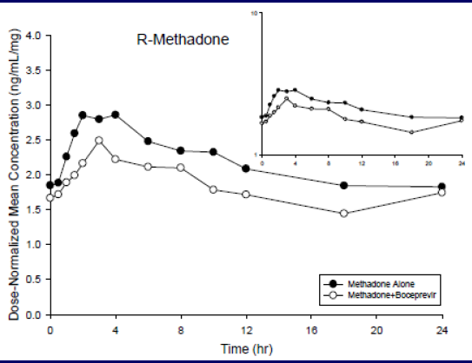
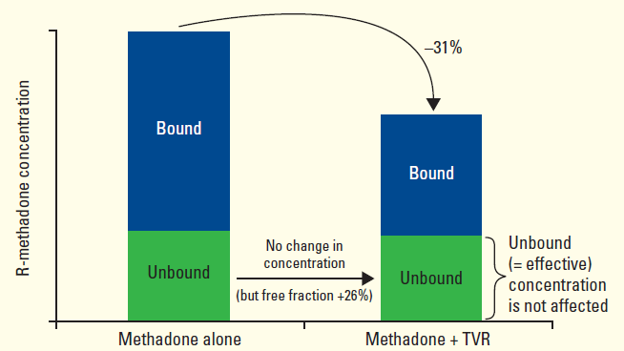
Methadone Interactions
Methadone is metabolized by CYP2B6, CYP2C19 & CYP3A, 85% protein bound; R-isomer is biologically active enantiomer
Boceprevir interaction:
  R-methadone AUC ↓ 16%, Cmax ↓ 10%; no withdrawal
Telaprevir interaction:
  R-methadone Cmin ↓ 31%, Cmax ↓ 21%, AUC ↓ 21%, but median unbound Cmin was unchanged, no withdrawal Sx
Hulskotte et al. 2012, Van Heeswijk et al. 2011.
Notes:
Methadone does not induce or inhibit CYP450 isoenzymes, so would not be expected to affect the pharmacokinetics of other agents including boceprevir and telaprevir.
Methadone is available as a combination of R- and S-isomers, and undergoes N-demethylation primarily via CYP3A4, CYP2B6, and CYP2C19 to inactive metabolites.[1] As such, the pharmacokinetics of methadone may be affected by other drugs which are CYP inducers or inhibitors.
Interaction Study with Boceprevir:
In HCV-negative volunteers on stable, maintenance doses (20-150 mg QD) of methadone, boceprevir 800 mg q8h was coadministered for 6 days. In the presence of boceprevir, exposures of R-methadone were decreased (AUC ↓ 16%, Cmax ↓ 10%) and S-methadone were decreased (AUC ↓ 22%, Cmax ↓ 17%). These changes did not result in clinically significant effects including withdrawal. Boceprevir exposures in the presence of methadone were similar to historical controls. Dose adjustment is likely not necessary when boceprevir is co-administered with methadone.[2]
Clinical monitoring is recommended, with dose adjustments of methadone if necessary during concomitant treatment with boceprevir.
Interaction Study with Telaprevir:
In HCV-negative volunteers on stable methadone maintenance therapy (median methadone dose 85 mg, range 40-120 mg/day), telaprevir 750 mg q8h was co-administered for 7 days. In the presence of telaprevir, R-methadone Cmin ↓ 31%, Cmax ↓ 21% and AUC ↓ 21%. The AUC ratio of S-/R-methadone was comparable before and during coadministration of telaprevir. The median unbound fraction of R-methadone ↑ from 7.92% to 9.98% during coadministration with telaprevir, but the median unbound Cmin of R-methadone was similar before and during telaprevir coadministration. A priori methadone dose adjustments are not required when initiating telaprevir, but close monitoring is recommended, with dose adjustments if necessary.[3]
References:
1. Gerber JG, Rhodes RJ, Gal J. Stereoselective metabolism of methadone N-demethylation by cytochrome P4502B6 and 2C19. Chirality 2004;16:36-44.
2. Hulskotte EGJ, Feng H-P, Bruce RD, et al. Pharmacokinetic interaction between HCV protease inhibitor boceprevir and methadone or buprenorphine in subjects on stable maintenance therapy [abstract PK_09]. 7th International Workshop on Clinical Pharmacology of Hepatitis Therapy, June 27-28, 2012, Cambridge, MA.
3. Van Heeswijk RPG, Vandevoorde A, Verboven P, et al. The pharmacokinetic interaction between methadone and the investigational HCV protease inhibitor telaprevir [abstract PK_18]. 6th International Workshop on Clinical Pharmacology of Hepatitis Therapy, June 22-23, 2011, Cambridge, MA.
95

Slide 96
Benzodiazepine Interactions
Majority are substrates of CYP3A4
  risk for prolonged/excessive sedation
Oral midazolam & triazolam are contraindicated with boceprevir and telaprevir
  5 to 9-fold ↑ midazolam AUC with boceprevir or telaprevir
  IV midazolam: consider ↓ dose, close monitoring for respiratory depression or prolonged sedation
Other benzodiazepines: ↓ dose and monitor
Consider using benzodiazepines that are glucuronidated: lorazepam, oxazepam, temazepam
Notes:
96
The majority of benzodiazepines are substrates of CYP3A4, and hence are susceptible to interactions with CYP3A4 inhibitors.
Significantly elevated benzodiazepine concentrations may result in prolonged or excessive sedative effects.
Midazolam is a CYP3A4 substrate. 5 to 9-fold ↑ AUC with boceprevir or telaprevir using oral midazolam. Therefore, oral midazolam is contraindicated with HCV protease inhibitors.
When administered intravenously, midazolam exposures are increased 3.4-fold by telaprevir; there are currently no data with boceprevir.
Co-administration with telaprevir should be done in a setting which ensures clinical monitoring and appropriate medical management in case of respiratory depression and/or prolonged sedation. Dose reduction for midazolam should be considered, especially if more than a single dose of midazolam is administered. Alternative options for short-term sedation: lorazepam (Ativan) or propofol (Diprivan)
Triazolam is also contraindicated with boceprevir & telaprevir.
For alprazolam, buspirone, diazepam, flurazepam, nitrazepam, zolpidem, zopiclone, eszopiclone: reduce benzodiazepine dose and titrate according to response.
An alternative is to use a benzodiazepine which undergoes a different route of metabolism. Oxazepam, lorazepam, and temazepam undergo glucuronidation, and may be less susceptible to inhibition interactions with DAAs.
References:
Garg V, Chandorkar G, Farmer HF, et al. Effect of telaprevir on the pharmacokinetics of midazolam and digoxin. J Clin Pharmacol 2012;Jan 26 [Epub ahead of print].
Kasserra C, Hughes E, Treitel M, et al. Clinical pharmacology of boceprevir: metabolism, excretion, and drug-drug interactions [abstract 118]. 18th Conference on Retroviruses and Opportunistic Infections, Feb 27-Mar 2, 2011, Boston, USA.
Merck Canada Inc. Victrelis (boceprevir) Product Monograph. Kirkland, Quebec, Canada, June 13, 2012.
Vertex Pharmaceuticals Inc. Incivek (telaprevir) Product Monograph. Laval, Quebec, Canada, August 11, 2011.

Slide 97
Using Statins with Boceprevir or Telaprevir
 | Boceprevir | Telaprevir
Lovastatin, Simvastatin | CONTRAINDICATED
Atorvastatin | May need to ↓ atorvastatin dose; do not exceed >20 mg/d | CONTRAINDICATED
Pravastatin | Start with recommended dose and monitor for toxicity. | Possible ↑ in statin; use with caution.
Rosuvastatin, Fluvastatin | Possible ↑ in statin; use with caution.
Use lowest statin dose and titrate slowly to response
Victrelis & Incivek Product Monographs, 2011; FDA HIV/AIDS Update, 2012.
Notes:
Atorvastatin – Lipitor; lovastatin – Mevacor; simvastatin – Zocor; rosuvastatin – Crestor; pravastatin – Pravachol; fluvastatin – Lescol
pitavastatin – Livalo (N/A in Canada) – via UGT
Most statins are substrates of the P450 system, primarily CYP3A4. However, there are some within-class differences:
atorvastatin, lovastatin, simvastatin: CYP3A4
rosuvastatin: <10% metabolized; 2C9, 2C19, Pgp?
pravastatin: 40-54% Clrenal; CYP3A(?), OATP1B1, OATP2B1
fluvastatin: CYP2C9 >>3A4 (minor)
Boceprevir and telaprevir can significantly increase concentrations of statins, which can lead to increased risk of toxicity including myopathy and rhabdomyolysis.
Atorvastatin 40 mg + boceprevir:
atorvastatin AUC ↑ 130% and Cmax ↑ 170% vs atorvastatin alone
Suggest ↓ atorvastatin dose with concomitant BOC; monitor for symptoms of statin toxicity if using >40 mg/d atorvastatin
Pravastatin 40 mg + boceprevir:
pravastatin AUC ↑ 60% and Cmax ↑ 50% vs pravastatin alone
Can initiate pravastatin at the recommended dose when co-administered with BOC, with close clinical monitoring
Atorvastatin 20 mg+ telaprevir:
In healthy subjects, the kinetics of single dose amlodipine 5 mg/atorvastatin 20 mg (coformulated) were assessed alone and with steady-state telaprevir 750 mg q8h. In the presence of telaprevir, atorvastatin Cmax ↑ 10.6-fold and AUC ↑ 7.88-fold.
Atorvastatin, lovastatin and simvastatin are contraindicated with telaprevir.
In March 2012, the FDA issued a Drug Safety Communication regarding the risk of increased toxicity with statins when combined with either HIV or HCV protease inhibitors. The product monographs were subsequently updated to reflect these dosing recommendations.
References:
Lee JE, Van Heeswijk RPG, Alves K, et al. Effect of the hepatitis C virus protease inhibitor telaprevir on the pharmacokinetics of amlodipine and atorvastatin. Antimicrob Agents Chemother 2011;55(10):4569-74.
Hulskotte EGJ, Gupta S, Xuan F, et al. Pharmacokinetic evaluation of the interaction between the HCV protease inhibitor boceprevir and the HMG-CoA reductase inhibitors atorvastatin and pravastatin [abstract 122]. HEP DART, December 4-8, 2011, Koloa, Hawaii.
U.S. Food and Drug Administration. HIV/AIDS Update - Important info about interactions between certain HIV drugs and cholesterol-lowering statin drugs. March 1, 2012.

Slide 98
Effect of Steady-State Telaprevir on the Pharmacokinetics of Amlodipine 5 mg
Calcium channel blockers (CCBs)
Amlodipine, diltiazem, felodipine, nifedipine, nicardapine, verapamil are CYP3A4 substrates
Concentrations may be ↑ by boceprevir or telaprevir
Use with caution, clinical monitoring
Consider dose reduction
amlodipine AUC ↑ 179%
monitor for dose-related toxicity
Lee et al. Antimicrob Agents Chemother 2011.
Notes:
Calcium channel blockers are CYP3A4 substrates, and drug concentrations may be increased in the presence of boceprevir or telaprevir. Caution is warranted and clinical monitoring of patients is recommended if concomitant therapy is required.
In healthy subjects, the kinetics of single dose amlodipine 5 mg/atorvastatin 20 mg (coformulated) were assessed alone and with steady-state telaprevir 750 mg q8h. In the presence of telaprevir, amlodipine Cmax ↑ 27% and AUC ↑ 179%. Monitor for dose-related amlodipine toxicity when coadministering with telaprevir.
Pharmacokinetic interactions are not expected with ACE inhibitors, most diuretics, and most beta-blockers which are excreted by the kidneys. Exceptions include the diuretic indapamide, and the beta-blockers propranolol and carvedilol, which are metabolized through a variety of CYP450 pathways including 3A4. These particular agents have not been studied with boceprevir or telaprevir, and the clinical significance of coadministration is unknown, since CYP3A4 is one of many isozymes involved in drug metabolism. Nevertheless, caution is warranted with these combinations. Clinicians may wish to consider initiating therapy with lower doses of these agents if patients are receiving DAAs.
References:
Lee JE, Van Heeswijk RPG, Alves K, et al. Effect of the hepatitis C virus protease inhibitor telaprevir on the pharmacokinetics of amlodipine and atorvastatin. Antimicrob Agents Chemother 2011;55(10):4569-74.
Merck Canada Inc. Victrelis (boceprevir) Product Monograph. Kirkland, Quebec, Canada, June 13, 2012.
Vertex Pharmaceuticals Inc. Incivek (telaprevir) Product Monograph. Laval, Quebec, Canada, August 11, 2011.

Slide 99
Interactions between DAAs and Transplant Drugs
Cyclosporine & tacrolimus are CYP3A4 substrates; significant ↑↑ concentrations with DAAs:
  cyclosporine: AUC ↑ 2.7-fold with boceprevir, ↑ 4.64-fold with telaprevir
  tacrolimus: AUC ↑ 17.1-fold with boceprevir, ↑ 70.3-fold with telaprevir
↓ CsA and TAC dosing with telaprevir coadministration:
  CsA: ↓ from 200 mg to 25 mg daily (n=7)
  TAC: ↓ to 50% dose given weekly (n=7)
Hulskotte et al. HEP DART 2011, poster 123. Garg et al. Hepatology, 2011. Mantry et al. HEP DART 2011, #90. Kwo et al. EASL 2012, #202.
Notes:
The immunosuppressive agents cyclosporine, tacrolimus and sirolimus are CYP3A4 substrates, and significant interactions have been noted with DAAs.
There are some preliminary data with telaprevir and either cyclosporine or tacrolimus which suggest that coadministration may be possible, with significant reductions in immunosuppressant dosing. These data are summarized below.
1) Cyclosporine:
a) Boceprevir. In healthy volunteers, the kinetics of single-dose cyclosporine 100 mg was assessed alone and in the presence of single dose BOC 800 mg and steady-state BOC 800 mg TID. In the presence of BOC, cyclosporine AUC increased 2.7-fold and Cmax increased 2-fold, while boceprevir pharmacokinetics were not affected by cyclosporine. Co-administration of cyclosporine with boceprevir may require dose adjustment of CsA and close monitoring of cyclosporine blood levels as well as frequent assessments of renal function and CsA-related side effects.[1]
b) Telaprevir. In healthy subjects, the pharmacokinetics of single dose cyclosporine was assessed alone at 100 mg and in the presence of steady-state telaprevir 750 mg q8h at a dose of 10 mg on day 1 and day 8. When coadministered with telaprevir, cyclosporine exposure increased 4.6-fold and the elimination t1/2 increased from 12 to 42 hours; the effect of first dose of telaprevir on cyclosporine kinetics was similar to the effect of steady-state telaprevir. Telaprevir kinetics were similar to historical data, suggesting no major effect of cyclosporine on telaprevir.[3]
In a case series, patients with recurrent HCV post-liver transplant with null response (<2 log decrease) to pegylated-interferon/ribavirin (PR) for ≥12 weeks received a 4 week lead-in with PEG-IFN α2b with ribavirin 600-1000 mg/d followed by addition of telaprevir 750 mg q8h. Patients on tacrolimus were converted to cyclosporine prior to starting telaprevir. On the first day of telaprevir therapy, the cyclosporine dose was decreased from an average of 200 mg to 25 mg per day, with a target CsA trough of 100 ng/mL. To date, 4 subjects have completed 12 weeks of telaprevir therapy. The average CsA dose at week 16 was 68 mg. All patients required a reduction in ribavirin dose; no episodes of renal toxicity secondary to increased CsA levels or rejection following the end of telaprevir therapy were observed.[2]
Tacrolimus
Boceprevir. In healthy volunteers, the kinetics of single-dose tacrolimus 0.5 mg was assessed alone and in the presence of single dose BOC 800 mg and steady-state BOC 800 mg TID. In the presence of BOC, tacrolimus AUC increased 17-fold and Cmax increased 9.9-fold; BOC pharmacokinetics were not affected by tacrolimus. Coadministration of BOC and tacrolimus would likely require significant dose reduction of tacrolimus and/or prolongation of the dosing interval, with close monitoring of tacrolimus concentrations and frequent assessments of renal function and tacrolimus-related side effects.[1]
Telaprevir. In healthy subjects, the pharmacokinetics of single dose tacrolimus was assessed alone (2 mg) and at a dose of 0.5 mg in the presence of steady-state telaprevir 750 mg q8h. When coadministered with telaprevir, tacrolimus exposure ↑ 70-fold and the elimination t1/2 increased from 40.7 to 196 hours; telaprevir kinetics were similar to historical data, suggesting no major effect of tacrolimus on telaprevir.[3]
In a case series, HCV-1a infected, post-liver transplant patients received pegylated interferon 2a/b, ribavirin, and telaprevir. All subjects were on stable tacrolimus dosing prior to starting antiviral therapy. Tacrolimus doses were pre-emptively reduced to 50% of pre-treatment doses and given once weekly. Trough TAC levels were checked q2d for the first 2 weeks, then weekly until telaprevir therapy was complete. Baseline TAC dosing was resumed after 5 days of stopping telaprevir. No episodes of acute rejection or TAC toxicity were noted; 4 patients had early rapid virologic response, 2 patients had complete early virologic response, 1 patient was a non-responder. The main adverse effect was anemia (n=6 required transfusions); dehydration, renal insufficiency and infections also reported.[4]
References:
Hulskotte EGJ, Gupta S, Xuan F, et al. Pharmacokinetic interaction between the HCV protease inhibitor boceprevir and the calcineurin inhibitors cyclosporine and tacrolimus [abstract]. HEP DART, December 4-8, 2011, Koloa, Hawaii.
Kwo PJ, Ghabril M, Lacerda M, et al. Use of telaprevir plus peg interferon/ribavirin for null responders post OLT with advanced fibrosis/cholestatic hepatitis C [abstract 202]. 47th Annual Meeting of the European Association for the Study of the Liver, April 18-22nd, 2012, Barcelona.
Garg V, Van Heeswijk RPG, Lee JE, et al. Effect of telaprevir on the pharmacokinetics of cyclosporine and tacrolimus. Hepatology 2011;54(1):20-7.
Mantry PS, Hassett MS, Weinstein J, et al. Triple therapy using telaprevir in the treatment of hepatitic C recurrence after liver transplantation: an early single center experience [abstract 90]. HEP DART, December 4-8, 2011, Koloa, Hawaii.

Slide 100
Drugs Contraindicated with Boceprevir and Telaprevir (1)
α1-adrenoreceptor antagonist | alfuzosin | hypotension, cardiac arrhythmia
antiarrhythmics | Quinidine, propafenone, amiodarone. Flecainide (TVR) | serious/life-threatening cardiac arrhythmia
antimycobacterials | Rifampin | Loss of virologic response
Ergot derivatives |  | Acute ergot toxicity
Herbal product | St. John’s wort | Loss of virologic response
Statins | Lovastatin, simvastatin. Atorvastatin (TVR) | Myopathy including rhabdomyolysis
neuroleptic | Pimozide | serious/life-threatening cardiac arrhythmia
Victrelis & Incivek Product Monographs, 2011
Notes:
Many other drugs from several different classes are at risk of drug interactions with DAAs. The product monographs of boceprevir and telaprevir provide a list of drugs with known or potential CYP3A4 interactions. Examples of interacting drug classes include benzodiazepines (e.g., midazolam), HMG coenzyme A reductase inhibitors (statins), macrolides, antimycobacterials (e.g., rifampin), anticonvulsants, antiarrhythmics, psychotropics, antifungals, erectile dysfunction drugs, antipsychotics, inhaled corticosteroids, calcium channel blockers and more.
References:
Merck Canada Inc. Victrelis (boceprevir) Product Monograph. Kirkland, Quebec, Canada, June 13, 2012.
Vertex Pharmaceuticals Inc. Incivek (telaprevir) Product Monograph. Laval, Quebec, Canada, August 11, 2011.

Slide 101
Drugs Contraindicated with Boceprevir and Telaprevir (2)
PDE-5 inhibitor | sildenafil. tadalafil (BOC); vardenafil (TVR) | Visual abnormalities, hypotension, prolonged erection, syncope
Sedatives/ hypnotics | oral midazolam, triazolam | Increased sedation or respiratory depression
Other | cisapride, astemizole, terfenadine | serious/life-threatening cardiac arrhythmia
Anticonvulsants (BOC) | carbamazepine, phenytoin, phenobarbital | Loss of virologic response
OC (BOC) | drospirenone | hyperkalemia
Aldosterone antagonist (TVR) | eplerenone | hyperkalemia
Triptans (TVR) | eletriptan | Coronary artery vasospasm, MI, vent. tachycardia, VF
Victrelis & Incivek Product Monographs, 2011.
Notes:
Many other drugs from several different classes are at risk of drug interactions with DAAs. The product monographs of boceprevir and telaprevir provide a list of drugs with known or potential CYP3A4 interactions. Examples of interacting drug classes include benzodiazepines (e.g., midazolam), HMG coenzyme A reductase inhibitors (statins), macrolides, antimycobacterials (e.g., rifampin), anticonvulsants, antiarrhythmics, psychotropics, antifungals, erectile dysfunction drugs, antipsychotics, inhaled corticosteroids, calcium channel blockers and more.
References:
Merck Canada Inc. Victrelis (boceprevir) Product Monograph. Kirkland, Quebec, Canada, June 13, 2012.
Vertex Pharmaceuticals Inc. Incivek (telaprevir) Product Monograph. Laval, Quebec, Canada, August 11, 2011.

Slide 102
Summary
Potential for numerous interactions between DAAs and ARVs, as well as agents prescribed by other providers
  challenge in treating HIV/HCV coinfected patients, particularly in context of earlier cART initiation, aging population and management of comorbidities
Steps to minimizing/managing interactions:
  ensure medication records are up to date at each visit
  utilize pertinent drug interaction resources to identify combinations of potential concern
  consult with physicians & pharmacists with expertise in HIV and HCV
  institute therapeutic plan with close monitoring

Slide 103
HIV & HCV
Drug Interaction Resources
Interactions in HCV and HIV:
  Kiser J et al. Hepatology 2012;55:1620-8.
  Tseng & Foisy. Curr Infect Dis Rep 2012;14:67-82.
Internet
  Toronto General Hospital Immunodeficiency Clinic; www.hivclinic.ca, www.hcvdruginfo.ca
  Liverpool Pharmacology Group; www.hep-druginteractions.org
Notes:
103

Slide 104
Complicated cases
David Fletcher, MD
Department of Medicine
University of Toronto

Slide 105
CASE 1
54 yr/o man
HIV positive 8 yrs ago
  Tenofovir/FTC/RTV/Atazanavir x 4 yrs
  Previously documented NNRTI resistance with Y181C, G190A,and mixed m184v/wt
  CD4 320 HIV Viral Load<40
Notes:
Significant 1st and second generation NNRTI resistance and 3TC/FTC resistance

Slide 106
CASE 1
Genotype 1a Hepatitis C biopsy proven cirrhosis
Compensated and clinically stable
  Previous therapy in 2009 with Peg IFN/1200mg RBV daily resulted in a null response by history from the patient

Slide 107
CASE 1
Patient is interested in a retrial of therapy for Hepatitis C with the new direct acting antiviral agents
Would you offer treatment?
Chance of cure?
Which 3rd agent would you choose and why?
Does patient’s antiretroviral history play a role in 3rd agent choice?
Is there a role for a 4 week lead in here regardless of agent chosen and if so…why?
Notes:
It is important to verify the exact response (i.e. by medical records if possible) to previous dual Hepatitis C therapy to help with an accurate assessment of the chance of cure with triple Hepatitis C therapy…in this case if a true null response to dual therapy (<2 log decline in HCVRNA at week 12) his chance of cure is probably no better than 10-15% as per monoinfection data in cirrhotic null responders.
In regards to choice of 3rd agent…this may be more dictated by patient preference (i.e. side effects/length of 3rd agent use) and available/possible HIV regimens and their drug interactions with the chosen 3rd agent.
Currently, there are some clinicians that would do a 4 week lead in here regardless of 3rd agent to document interferon responsiveness (i.e. < or > 1 log reduction in HCV RNA at week 4) as the chance of cure here would likely be significantly <10% if there is a less than 1 log decline in HCVRNA at week 4…one could then choose to await newer/more potent agents in this situation…of course this must be balanced by the risk of hepatic decompensation while awaiting the development and subsequent coverage of these newer therapies.

Slide 108
CASE 1
It was decided to move forwards with Peg IFN/ 1200mg RBV/Telaprevir
Is it necessary to change current ARVs?
Would it be necessary to change ARVs if Boceprevir was chosen?...to what?
Notes:
There is PK and clinical data to support the concomitant use of Atazanavir with Telaprevir…Atazanavir levels are slightly increased and Telaprevir levels slightly decreased…these changes are generally felt to be clinically insignificant
In regards to Boceprevir…there seems to be more significant interactions with the HIV Protease inhibitors whereby HIV PI levels are generally decreased as are Boceprevir levels…having said that, clinically, it is unclear whether these PK changes are clinically significant in a suppressed HIV patient with the addition of the modest anti-HIV activity of Interferon
The switch in ARV regime in order to use Boceprevir here would be complicated…this is particularly so due to the existence of m184v…Atazanavir levels would be similar to unboosted levels but these would be further lowered by Tenofovir and with the existence of pre-existing NRTI resistance this could lead to rebound HIV viremia….perhaps one could consider a combination of Abacavir/Tenofovir/FTC/Raltegravir

Slide 109
CASE 1
Peg IFN/1200mg RBV/Telaprevir…no lead in performed
Week 0 HCVRNA 3.7 x 10e7
Week 4 HCVRNA detectable but<12
Would you continue?
Are you concerned about the result?
When would you do the next HCVRNA?
Notes:
The initial response is excellent with 7 log reduction in HCVRNA!!!...the next official time point to do an HCVRNA would be week 12 although one could do another HCVRNA at any time to ensure HCVRNA is not rising in this situation as a result of early resistance.

Slide 110
CASE 1
It was decided to continue with Peg IFN/1200mg RBV/Telaprevir and HCVRNA rechecked
Week 0 HCVRNA 3.7 x 10e7
Week 4 HCVRNA detectable but<12
Week 6 HCVRNA <12
Would you continue?
Notes:
Great results so would continue.

Slide 111
CASE 1
Peg IFN/1200mg RBV/Telaprevir
Week 0 HB 140
Week 2 HB 125
Week 4 HB 109
Week 6 HB 99…symptomatic
How would you manage anemia?
Notes:
Anemia management has evolved of recent on triple therapy…One could transfuse, drop RBV dose, use Erythropoetin or do a combination thereof…when compared, all are equally efficacious and virologic outcomes are similar. There may be fewer secondary interventions when managing anemia using RBV dose adjustment initially. Finally RBV dose adjustment is probably the simplest/most cost effective and the amount of dose adjustment (i.e. 10%, 25%, 50%) does not seem to correlate with a negative outcome regarding HCV treatment responses with direct acting antiviral agents.
One maneuver that has been shown to be detrimental would be dose adjustment of /or stopping Telaprevir/Boceprevir. This should never be done to manage anemia.

Slide 112
CASE 1
Peg IFN/600mg RBV/Telaprevir
Week 0 HCVRNA 3.7 x 10e7
Week 4 HCVRNA detectable but<12
Week 6 HCVRNA <12 HB 99 (symptoms)
Week 8 HCVRNA <12 HB 98 (less symptomatic)
What would you do?
How would you further manage anemia
Notes:
Great results and happy with both HCVRNA and Hemoglobin…would continue as is with RBV 600mg/day and monitor hemoglobin.

Slide 113
CASE 1
Peg IFN/600mg RBV/Telaprevir
Week 0 HCVRNA 3.7 x 10e7
Week 4 HCVRNA detectable but<12
Week 6 HCVRNA <12
Week 8 HCVRNA <12
Week 12 HCVRNA detectable but <12 HB 103
What would you do?
When would you do your next HCVRNA?
Notes:
A concerning HCVRNA as this potentially represents an increase. The result could be a false positive so definitely would want to repeat ASAP.
It would be important (although perhaps too late) to check regarding adherence to therapy and ensure this is not an issue.
It is unclear, but unlikely that this represents too aggressive a drop in RBV dosing. One cannot be 100% certain of that though given that Telaprevir has been completed, we could re-increase the dose of RBV given stability of Hemoglobin.

Slide 114
CASE 1
Peg IFN/RBV re-increased to 1200mg
Week 0 HCVRNA 3.7 x 10e7
Week 4 HCVRNA detectable but <12
Week 8 HCVRNA <12
Week 12 HCVRNA detectable but <12
Week 14 HCVRNA <12 HB 101
What would you do?
Notes:
Great results….would follow closely

Slide 115
CASE 1
Peg IFN/1200mg RBV
Week 0 HCVRNA 3.7 x 10e7
Week 4 HCVRNA detectable but<12
Week 12 HCVRNA detectable but <12
Week 14 HCVRNA <12 HB 101
Week 24 HCVRNA <12 HB 105
How much longer would you treat?
When would you do your next HCVRNA?
Notes:
Minimum time to treat would be for a total of 48 weeks, so one would treat for an additional 24 weeks of PEG IFN/RBV.
One could argue that with 2 values of HCVRNA being detectable within the first 12 weeks that this patient is a slow responder given the existence of cirrhosis/previous null response/HIV related immunosuppression one could consider extending the treatment duration here beyond 48 weeks to decrease the risk of relapse. There is a paucity of data in this patient group (i.e. HIV/cirrhosis/null responder) to make an informed decision.

Slide 116
CASE 1
Peg IFN/1200mg RBV
Week 0 HCVRNA 3.7 x 10e7
Week 4 HCVRNA detectable but <12
Week 12 HCVRNA detectable but <12
Week 24 HCVRNA <12
Week 36 HCVRNA <12
Week 48 HCVRNA <12
Are we finished therapy?
Notes:
From a Telaprevir algorithmic standpoint we are done with therapy but again one could consider extending therapy for an additional 24 weeks to potentially decrease the risk of relapse assuming the patient is informed and willing. It is difficult to know whether this week 12 HCVRNA was truly a real value (or may have been impacted by lower RBV dosing).

Slide 117
CASE 1
An additional 24 weeks of PEG IFN/RBV (for a total of 72 weeks of therapy) was offered to the patient given the existence of cirrhosis and ?slow HCVRNA clearance as evidenced by a detectable HCVRNA at week 4 and 12
Week 12 and 24 HCVRNA post 72 weeks of therapy were undetectable!

Slide 118
CASE 2
52 yo man
HIV positive 5 yrs ago
  CAD with previous MI 3 yrs ago/Hypertensive/Hypothyroidism
Tenofovir/FTC/Raltegravir x 4 yrs
  CD4 700 HIV Viral Load<40

Slide 119
CASE 2
Hypercholesterolemia and Hypertriglyceridemia on combination therapy with Atorvastatin 80mg/day and Fenofibrate 145mg/day
Hypertension controlled on Amlodipine 10mg/day
Hypothyroidism controlled on 0.125 mg L-Thyroxine

Slide 120
CASE 2
Genotype 1a chronic hepatitis C
Naïve to therapy
F2-3/4 scarring
Ready to start triple therapy with PEG IFN/RBV/Boceprevir
Atorvastatin decreased to 40mg/day
Baseline HCVRNA 1.66X10E6

Slide 121
CASE 2
Week 0 HCVRNA 1.66x10E6
Week 4 HCVRNA (lead in) 2.37x 10E2
Week 8 HCVRNA <12
At week 10 begins to feel tired/weak/constipated/muscle cramping
TSH noted to be 18.91…L-T4 increased to 0.15mg/d in response

Slide 122
CASE 2
At week 11 notes increasingly prominent myalgias, more predominant post interferon injection but lasting all week long as opposed to a few hrs post injection, along with increasing weakness
Hb stable at 105g/l over last few weeks with RBV dose reduction to 600mg/d
AST noted to be increasing while ALT has been normalizing over the last few weeks…also increasing swelling of ankles
  ?Cause…Hepatic Decompensation?

Slide 123
CASE 2
CK measured at 83,700
BP noted to be low at 90/55 and swelling of ankles worsened now to mid calf…no ascites noted clinically
Cause?
Notes:
Rhabdomyolysis is rare with lipid lowering agents. Having said that, there is an increased risk at higher doses, dual therapy with a fibrate, and hypothyroidism. Keep in mind that through inhibition of CP450 3A4 via Boceprevir, Atorvastatin levels will be increased above and beyond that expected. This medication should have been held, or at least dosed dramatically lower or switched to an agent with less metabolism via CP450 3A4 (i.e. Pravastatin/Rosuvastatin). The correct thing to do here now is to correct hypothyroidism and stop Atorvastatin and Fenofibrate.
Again, Amlodipine is metabolized by CP450 3A4, and hence Bocperevir increases levels of this medication. Common side effects in this situation would include peripheral edema, hypotension/dizziness/weakness, and constipation. His medication should have either been switched to another antihypertensive or the dose should have been dramatically reduced (i.e. 2.5mg) with careful observation.

Slide 124
CASE 2
Atorvastatin and Fenofibrate discontinued!!!
CK fell over the next few weeks as did AST
The symptomatic myalgias and weakness improved over the subsequent month
Amlodipine discontinued…BP normalized to 130/80 and ankle swelling disappeared over the next month

Slide 125
Future Trials of Hepatitis C Therapy in the HIV Co-infected
Stephen D. Shafran, MD, FRCPC, FACP
Department of Medicine, Division of Infectious Diseases
University of Alberta

Slide 126
Ongoing Clinical Trials of HCV Therapy in the HIV Co-infected
As of November 2012, the following regimens are under ongoing study:
IFN-containing (only for HCV genotype 1)
  PegIFNα-2a + RBV* + NS3 Protease Inhibitors
    PegIFNα-2a + RBV + telaprevir
    PegIFNα-2a + RBV + simeprevir
    PegIFNα-2a + RBV + faldaprevir
  PegIFNα-2a + RBV + NS5A Inhibitor
    PegIFNα-2a + RBV + daclatasvir
IFN-sparing (only for HCV genotypes 2 & 3)
  Sofosbuvir (nucleotide polymerase inhibitor) + RBV
* RBV = ribavirin
www.clinicaltrials.gov
Notes:
Source of information is: www.clinicaltrials.gov

Slide 127
  Two Ongoing Studies of PegIFNα-2a + RBV + Telaprevir in the HIV Co-Infected
Trial name | Vertex 115 | INSIGHT
Trial identifier | NCT01467479 | NCT01513941
Study design | Open-label | Open-label
No of subjects | 160 | 150
HCV patient types | GT1 Naïve, relapsers, partial responders, null responders
Telaprevir dosing* | 1125 mg BID x 12 wk | 750 mg TID x 12 wk
Study locations | USA, Canada, Spain, Germany | Europe, Australia, Brazil
Duration of PR | RGT (24 or 48 wk) in naives and relapsers; 48 wk in partials and nulls
RBV dose | 800 mg/d
ART | Must be on suppressive ART
Baseline CD4 | > 300 cells/mm³
Study status | Fully enrolled | Enrolling
SVR12 expected | Q3 2014 | Q3 2014
* Telaprevir dosed 1125 mg TID in patients receiving efavirenz
www.clinicaltrials.gov
Notes:
Source of information is: www.clinicaltrials.gov
The Vertex 115 study is being conducted by Vertex
The INSIGHT Study is being conducted by Janssen
There are some restrictions on permitted ARV drugs
Compensated cirrhotics allowed

Slide 128
  Ongoing Study of PegIFNα-2a + RBV + Simeprevir in the HIV Co-Infected
Trial name | C212
Trial identifier | NCT01479868
Study design | Open-label
No of subjects | 107
HCV patient types | GT1 Naïve, relapsers, partial responders, null responders
Simeprevir dosing | 150 mg QD x 12 wk
Study locations | USA, Europe, Canada
Duration of PR | RGT (24 or 48 wk) in naives and relapsers; 48 wk in partials/nulls/cirrhotics
RBV dose | 800 mg/d
ART and CD4 | CD4 > 300 on suppressive ART; or not on ART with CD4 > 500 and HIV RNA <100,000
Study status | Fully enrolled
SVR12 expected | Q4 2014
www.clinicaltrials.gov
Notes:
Source of information is: www.clinicaltrials.gov
Simeprevir, formerly TMC-435, was originally created by Medivir (a small Swedish company), and is being developed by Janssen
There are some restrictions on permitted ARV drugs
Compensated cirrhotics allowed

Slide 129
  Ongoing Study of PegIFNα-2a + RBV + Faldaprevir in the HIV Co-Infected
Trial name | STARTverso4
Trial identifier | NCT01399619
Study design | open-label with multiple randomizations
No of subjects | 306
HCV patient types | GT1 Naïve, relapsers
Faldaprevir dosing | 120 mg or 240 mg QD
Study locations | USA, Europe, Brazil
Duration of PR | RGT in naives and relapsers; 48 wk in partials/nulls/cirrhotics
RBV dose | 1000/1200 mg/d
ART and CD4 | CD4 > 300 on suppressive ART, OR not on ART with CD4 > 500 and pVL <100,000
Study status | Fully enrolled
SVR12 expected | Q4 2014
www.clinicaltrials.gov
Notes:
Source of information is: www.clinicaltrials.gov
Faldaprevir, formerly BI-201335, was created by Boehringer-Ingelheim (in their Laval, QC facility) and is being developed by Boehringer Ingelheim
There are some restrictions on permitted ARV drugs
Compensated cirrhotics allowed

Slide 130
PegIFNα-2a + RBV + Faldaprevir for HCV GT1 in HCV Treatment-Naïve and Relapser Patients with HIV Co-infection
PegIFN/RBV
PegIFN/RBV
Faldaprevir
240 mg QD + PegIFN/RBV
Follow-up:
up to Week 120
Faldaprevir
240 mg QD + PegIFN/RBV
PegIFN/RBV
*
Faldaprevir
120 mg QD + PegIFN/RBV
PegIFN/RBV
Day 1
Week 12
Week 24
Week 48
Week 120
Randomization
(1:1)
Randomization
(1:1)
ETS patients are re-randomized (1:1)
No ETS = 48 weeks PegIFN/RBV
ETS (early treatment response): HCV RNA <25 IU/mL, detectable or not at Week 4 and <25 IU/mL, undetectable at Week 8
* Patients directly assigned to the 240 mg dose group if receiving efavirenz and
to the 120 mg dose group if receiving darunavir/ritonavir or atazanavir/ritonavir

Slide 131
  Ongoing Study of PegIFNα-2a + RBV + Daclatasvir in the HIV Co-Infected
Trial name | COMMAND-HIV
Trial identifier | NCT01471574
Study design | open-label
No of subjects | 300
HCV patient types | GT1 Naïve
Daclatasvir dosing | 30 mg QD (ATZ/r, LPV/r or DRV/r), 60 mg QD (RAL, RIL or no ART) or 90 mg QD (EFV or NVP), all for 24 weeks
Study locations | USA, Europe, Brazil
Duration of PR | RGT (24 or 48 wks)
RBV dose | 1000/1200 mg/d
ART and CD4 | CD4 > 100 on suppressive ART, or not on ART with CD4 > 350
Study status | GT 1a capped. Still enrolling GT1b.
SVR12 expected | Q2 2014
www.clinicaltrials.gov
Notes:
Source of information is: www.clinicaltrials.gov
Daclatasvir, is the most developed HCV NS5A replication complex inhibitor. It is currently in phase 3 for HCV GT1 mono-infected treatment naïve patients.
It has significantly greater activity vs GT 1b than 1a, but is also active vs GT 2,3 and 4.
Daclatasvir was discovered by and is being developed by Bristol-Myers Squibb.
There are some restrictions on permitted ARV drugs
Compensated cirrhotics allowed

Slide 132
  Ongoing Study of Sofosbuvir + RBV in the HIV Co-Infected
Trial name
Trial identifier | NCT01667731
Study design | open-label
No of subjects | 115
HCV patient types | GT 2 and 3 Naïve and PR failures
Sofosbuvir dosing | 400 mg QD x 12 wk (naïve) or 24 wk (TF)
RBV dosing | 1000/1200 mg/d x 12 wk (naïve) or 24 wks (TF)
Study locations | USA
ART and CD4 | CD4 > 200 on suppressive ART, or not on ART with CD4 > 500
Study status | Enrolling
SVR12 expected | Q1 2014
www.clinicaltrials.gov
Notes:
Source of information is: www.clinicaltrials.gov
Compensated cirrhotics allowed

Slide 133
Future Trials of Anti-HCV Therapy Anticipated in the HIV Co-infected
Following completion of DDI studies identifying compatible ARVs, the following promising IFN-free anti-HCV regimens in the HCV-mono-infected may be tested in the HIV+ population:
  Sofosbuvir + RBV (likely GT 2 and 3 only)
  Sofosbuvir + NS5A inhibitor (likely pangenotypic)
    SOF + GS-5885 fixed-dose combination (FDC)
    SOF + Daclatasvir
  NS3 + NNI + RBV (GT1 only)
    Faldaprevr + BI-207127 + RBV in GT1b or GT1a/IL-28B CC
    Telaprevir + VX-222 + RBV
  NS3 + NNI + NS5A ± RBV
    ABT-450/ABT-267/RTV (FDC) + ABT-333 ± RBV
Notes:
The 6 regimens listed on this slide have all been shown to result in SVR in phase 2 studies in small numbers of HCV mono-infected patients.
To date, the only IFN-free regimen for which SVR results have been reported in patients with cirrhosis is faldaprevir + BI-2077127 + RBV (10% of the patients in the SOUND-C2 Study had cirrhosis), but cirrhotic patients have been enrolled in the phase 3 program of sofosbuvir + RBV in GT 2 and 3.
It is anticipated that promising IFN-free regimens in the HCV mono-infected will be studied in the HIV co-infected once relevant DDI studies have been completed, and clinically significant DDIs are either avoided or managed by dose adjustment.

Slide 134
HCV Infection in Marginalized Populations
Brian Conway, MD, FRCPC
Vancouver Infectious Diseases Centre (VIDC)
Notes:
With the advent of newer treatments holding the promise of cure of HCV infection in the vast majority of cases, there is a need to develop approaches that will lead to the engagement in care of as many infected men and women as possible. This must involve consideration of approaches that will attract those who do not traditionally engage the medical system on an ongoing basis, the so-called marginalized populations.

Slide 135
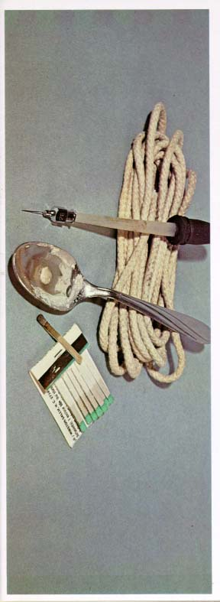
IDUs will drive the future HCV epidemic in Canada
300,000 HCV-infected Canadians, including over 180,000 IDUs (60% of prevalent cases)
14,000 new cases are diagnosed each year, including over 11,000 in IDUs (78% of incident cases)
Traditional medical models (diagnosis-treatment-prognosis) will NOT apply to their engagement in care and successful implementation of successful antiviral therapy
Remis, Health Canada, 2004. Fischer et al. Can J Pub Health, 2006. Zou. Can J Pub Health, 2003.
Notes:
For HCV, quite specifically, we are dealing with injection drug users, or IDUs. Of 300,000 HCV-infected Canadians, over 60% of prevalent and almost 80% of incident cases come from this population. Traditionally, the approach to evaluating such a large population of individuals in treatment would be to offer diagnostic testing on a widespread basis and expect the targeted individuals or groups to seek out testing, return for results, and then decide on initiation of treatment based on questions of efficacy and toxicity, bearing in mind the prognosis of disease in the untreated state. For IDUs, such a model is unlikely to be successful. Rather, community-based interventions will be required to encourage potential patients to seek testing, then separate strategies to ensure that those requiring specific treatment not only initiate but complete it with the required degree of adherence will need to be developped.

Slide 136
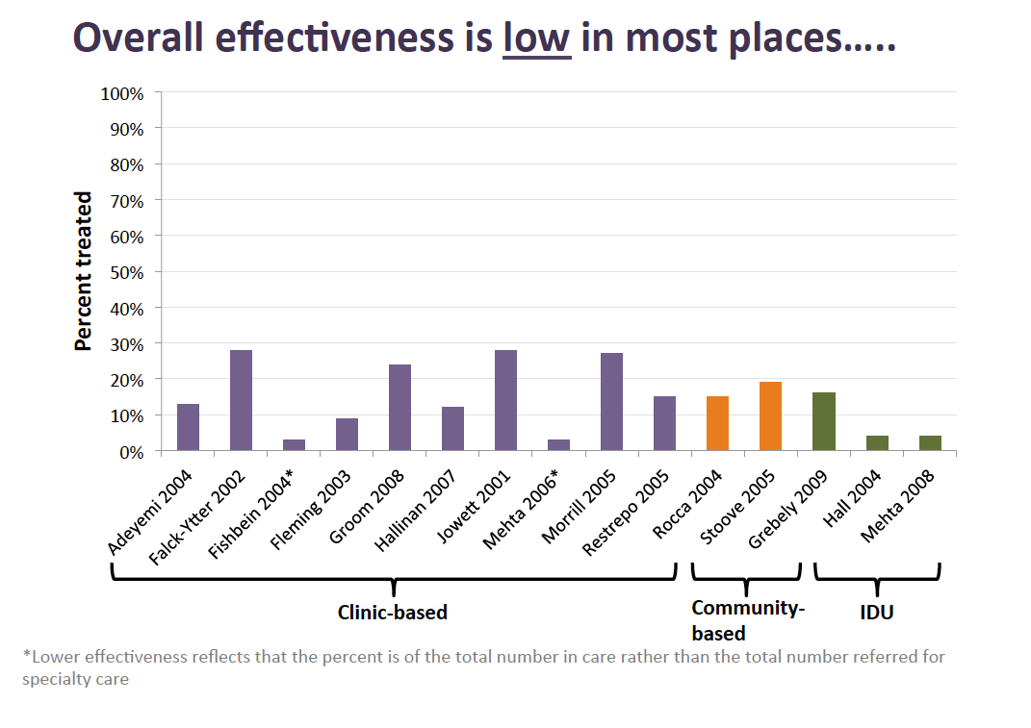
HCV Treatment Uptake Overall
Overall treatment uptake is low in most places…..
S. Mehta, with permission
Notes:
Irrespective of the setting, under 30% of persons infected have received treatment for HCV. Treatment rates are particularly low for IDUs with published rates ranging from 3-15%.

Slide 137
Treatment Uptake in HIV-HCV Co-infection
 | N | Cohort | HCV Treatment Uptake
Canada (Vancouver) (Grebely et al. J Viral Hep 2008) | 1,361 | Urban clinic of HCV & HIV/HCV co-infected patients | 1.1%
United States (Baltimore) (Mehta et al. AIDS 2006) | 845 | Urban clinic of HIV/HCV co-infected patients | 3.4%
Australia (NCHECR 2005) | 2,500 | Needle exchange | 4.0%
NCHECR, 2003. Australia.
Grebely et al. J Hepatology, 2006.
Notes:
137
To date, our record at engagement in HCV treatment care of co-infected populations has been modest at best. In inner city neighborhoods of Vancouver, barely 1% of the target population that could benefit from treatment has been prescribed HCV therapy. Even more established programs in the United States and Australia have fared little better, with less than 5% of the patients who are eligible to receive antiviral therapy having actually been prescribed it.

Slide 138
Barriers to HCV Treatment
Structural Barriers
Lack of infrastructure/multidisciplinary support
Segregated services
Provincial regulations
Cost
Provider Barriers
Poor awareness/education
Reticence to treat IDUs
Lack of providers, especially in remote communities
Focus on HIV
Patient Barriers
Poor awareness/ education
Lack of symptoms
Competing health priorities (HIV, psychiatric)
Competing social priorities (housing, substance use, financial)
Fear of side effects
Notes:
There are a number of barriers to the provision of HCV therapy that particularly impact vulnerable persons with HIV-HCV co-infection. Asymptomatic patients may not desire therapy with complex regimens that are often associated with important toxicities. Committing to therapy that could extend up to 48 weeks (including close medical follow-up that may often occur every week) may be problematic for individuals with numerous competing priorities for their health and social circumstances. Some of these barriers may be overcome with improved education, peer support and through addressing social needs and treatment for substance use. Providers also may lack education about the contraindications, benefits and risks of HCV therapy in this population and may be reticent to offer complicated treatment to active IDUs. Management of competing health issues, such HIV and psychiatric disease may take precedence. Finally there are many structural barriers to optimal provision of care. For example, lack of multidisciplinary support and segregation of specialty, primary care, psychiatric and addictions services may make appropriate care and follow-up unmanageable. Regulations regarding accessibility to treatment for HCV especially for HIV-infected patients can differ across provincial jurisdictions and finally, the up-front direct and indirect costs of therapy that have not been budgeted in current government-funded health care delivery programs are an increasing concern.

Slide 139
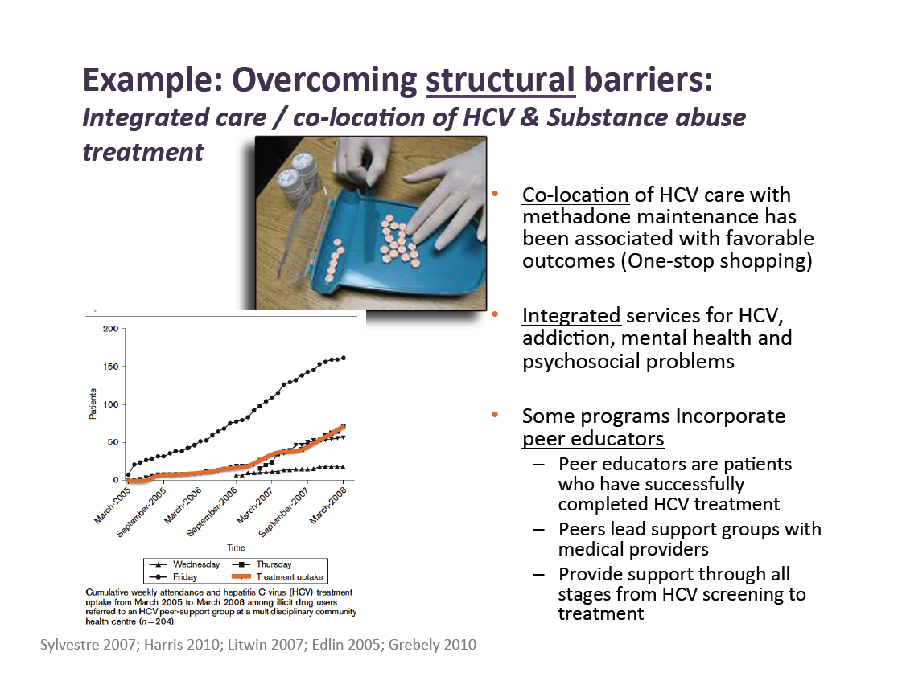
Example: Overcoming structural barriers:
Integrated care / co-location of HCV & Substance abuse treatment
Co-location of HCV care with methadone maintenance has been associated with favorable outcomes (One-stop shopping)
Integrated services for HCV, addiction, mental health and psychosocial problems
Some programs Incorporate peer educators
  Peer educators are patients who have successfully completed HCV treatment
  Peers lead support groups with medical providers
  Provide support through all stages from HCV screening to treatment
Sylvestre 2007; Harris 2010; Litwin 2007; Edllin 2006; Grebely 2010. S. Mehta, with permission
Notes:
Peer support and peer education has been demonstrated to be very effective at increasing uptake and retention in HCV care among IDUs before, during and after HCV treatment initiation as has been credited with increased HCV treatment uptake in several studies as illustrated in this slide.

Slide 140
Canadian situation
2007 Canadian consensus guideline reads: An appropriately funded multidisciplinary effort is required to improve care strategies for HCV infected IDU. Antiviral therapy should be considered in selected patients in whom HCV related morbidity & mortality will become relevant.
BUT 80% of Canadian physicians specialized in treating viral hepatitis would not treat active drug users
Myles et al. Can J Gastroenterology, 2011
Notes:
In Canada, official guidelines have supported treatment for HCV-infected IDU for over 5 years. However, a recent survey conducted among physicians who would be the key drivers of such treatment suggests that barely one in five would consider it. Despite the obvious medical need, there is a clear reluctance to address an important segment of the population living with HCV infection. Ref: Myles A, Wang C et al Physicians’ Attitudes and practice toward injection drug users with hepatitis C: results from a national specialist survey in Canada, Can J Gastroenterology, 2011.

Slide 141
Academic & Community Partnership Care Model
In the community
Community & Academic Partnership
ONE STOP SHOP
Multidisciplinary
  Physicians (addiction & hepatology)
  Nurses
  Outreach workers
  Research assistants
Culture of research & excellence
Notes:
One approach that has been hypothesized to be an ideal way to enhance treatment uptake and success in vulnerable communities is a “ONE STOP SHOP” model based in the community. The program would need to be multidisciplinary, with engagement of all members of the health care team, including outreach workers. Systematic data would need to be collected on all aspects of the program, to measure and quantify the results, to define the correlates of successful engagement in diagnosis and treatment and to promote the culture of excellence our patients deserve.

Slide 142
Patient Characteristics and Response Rates
Mean age 43, 83% male, 55% genotype 2/3
Early discontinuation - 11 patients (28%)
Treatment-limiting adverse events – 5 patients (13%)
  nausea/vomiting, tinnitus, neutropenia, depression, anemia
Illicit drug use – 6 patients (15%)
n=40
n=40
Grebely et al. J Gastroenterology and Hepatology, 2007.
Notes:
In our Vancouver based community clinic, the experience with our first 40 completed courses of treatment was very encouraging. We treated a group that was preferentially male and having non-1 HCV genotype. Only 28% discontinued treatment prematurely, with those not completing the assigned course of therapy equally divided between those who did not respond and those who were not adherent due to a significant relapse in street drug use. On a strict intent-to-treat analysis, fully 22 (or 55%) were cured of HCV, or 76% of those who completed treatment. These figures are similar to those expected in a non-IDU group, and speaks to the potential for success of our novel multidisciplinary model.

Slide 143
Impact of Illicit Drug Use on Response
35% used illicit drugs in the last 6 months
48% used illicit drugs during treatment
10 (25%) used occasionally (monthly or once/twice)
9 (23%) used frequently (every day/every other day)
n=26
n=14
n=21
n=19
n=10
n=9
Grebely et al. J Gastroenterology and Hepatology, 2007.
Notes:
We were further interested in determining whether ongoing illicit drug use was a predictive factor in the success of therapy. As it turns out, requiring that patients be abstinent from IDU for 6 months was not a predictor of success, at least with our support program for those on treatment. Further, it is only frequent drug use (> 3 times per week) that seemed to impact treatment success. This suggests that as long as patients are stable enough to attend clinic on a regular basis and are encouraged to do so, treatment should be considered.

Slide 144
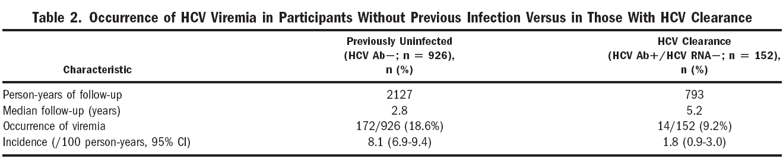
Occurrence of Viremia in IDUs
After adjusting for potential confounders:
  Individuals with viral clearance were 4 times less likely to develop infection than those infected for the first time
THESE DATA MAY NOT (OR MAY) APPLY TO TREATMENT-INDUCED VIROLOGIC CLEARANCE
Grebely et al. Hepatology, 2006.
Notes:
An important issue to consider is the likelihood of recurrent viremia in patients who are successfully treated for HCV, especially IDUs at risk of re-exposure to the virus. In a retrospective study of over 1,000 individuals most of whom were active drug users at risk of acquiring HCV infection, over 150 who had experienced spontaneous clearance of viremia, 186 viremic events were noted to occur with median follow-up of 3 and 5 years, respectively, for those who were previously uninfected and who had spontaneaously cleared. Controlling for duration of follow-up, such events were 4-5 times more frequent in previously uninfected individuals, suggesting some protective effect of prior exposure to the virus with respect to viremia in the setting of high risk behaviors. Although these data cannot be extrapolated to the situation of treatment-induced clearance, they certainly suggest that it may be legitimate to consider treatment even in the setting of possible re-exposure to the virus, and that active IDU should not represent a contraindication to treatment of HCV infection.

Slide 145
VIDC Baseline Characteristics
Characteristic | n (%)
Total treatment cases, (n) | 302
Median Age in yrs (Range) | 53 (34-70)
Female, n (%) | 44 (15)
HIV co-infection, n (%) | 43 (14)
HCV genotype, n (%) Genotype 1 Genotype 2/3 | 189 (63) 113 (37)
Treatment experience, n (%) Naïve Experienced | 252 (83) 50 (17)
Liver Cirrhosis, n (%) History of recent IDU, n (%) On methadone maintenance therapy, n (%) | 33 (11) 302 (100) 211 (70)
Notes:
To illustrate a model of care that can be successful in treating risk IDUs, we present data from an expanded cohort of patients treated within the Vancouver Infectious Diseases Centre (VIDC) program between 2003 and 2012. All viremic adults in whom treatment was medically indicated, in whom there were no absolute contraindications to the use of either interferon or ribavirin and for whom structures were in place to support adherence were considered for this cohort analysis. This was an observational cohort of the standard care for HCV infection. Detailed baseline demographic information was collected on all patients. Patients attended clinic weekly, at which time adherence and toxicity were systematically monitored, interferon injections were administered by our staff and the weekly supply of ribavirin was dispensed. The key endpoint that was evaluated was the absence of viremia 24 weeks after the end of treatment, or sustained virologic response (SVR). This is generally understood to represent a cure of the HCV infection.
After 302 courses of treatment, in men and women ranging in age from 34 to 70; 15% of the cohort was female while 14% were co-infected with HIV. As reflects the genotype distribution in the community served, about 40% were infected with genotype 2 or 3 virus. About 5/6 were HCV treatment-naïve, and a small minority were compensated cirrhotics. None of the treated patients met the criteria of being free of IDU for 6 months or more, and a majority were enrolled in a methadone maintenance program to deal with heroin addiction, this medication being daily dispensed and allowing us an additional measure of follow-up and engagement of the target population.

Slide 146
Number of patients initiating treatment N=302
Notes:
Over time, we can see that we are able to initiate treatment in 50-60 individuals per year at the VIDC, with 2012 representing about a half-year of data, limited to patients in whom a course of treatment has been completed. Our rate of engagement in care and treatment initiation has been quite stable over the past 3 years.

Slide 147
SVR rates in all treated and evaluable patients N=251
Notes:
Success rates overall are between 47-53%, 10-15% higher in patients with non-genotype 1 HCV. Remarkably, HIV co-infection did not seem to greatly affect success rates, irrespective of the genotype of the virus.

Slide 148
Treatment Discontinuation in all treated and evaluable patients; n=251
 | Genotype 1 N=155 | Genotype 2/3 N=96 | Overall N=251
Completed Therapy | 95 (61%) | 72 (75%) | 167 (67%)
Discontinued due to: Lack of Response Drug Toxicity Non-adherence / drug relapse | 60 (39%) 37 (24%) 13 (8%) 10 (7%) | 24 (25%) 7 (7%) 14 (15%) 3 (3%) | 84 (33%) 44 (17%) 27 (11%) 13 (5%)
Notes:
It is further remarkable that 2/3 patients completed therapy, with more discontinuations seen in the setting of genotype 1 infection due to mandated early discontinuations at week 12 due to lack of virologic response. Indeed, this is reflected by the rate of discontinuation for that reason of 24% vs. 7% for genotype 2/3. The higher drug toxicity rates seen with genotype 2/3 are likely a factor of increased duration of exposure to the HCV treatment rather than any genotype-specific phenomena. It is finally quite encouraging to observe that only 5% were lost due to non-adherence or drug relapse, speaking both to the robustness of patient selection and support services offered at our site.

Slide 149
HCV Treatment Discontinuation Rates in IDUs vs. non-IDUs
Lee et al. (Liver Int. 1270-77, 2012)
8853 courses of Peg-IFN-2a in non-IDUs
68.3% completion rate
10.3% discontinuation for toxicity
Notes:
Our completion and discontinuation rates are almost identical to those reported in almost 9,000 courses of treatment described by Lee et al in 2012, in a population from which IDUs were almost completely excluded.

Slide 150
Conclusions
HCV infection can be treated successfully in IDUs with response rates and patterns of treatment discontinuation similar to those seen in other populations, independent of HIV co-infection status.
As reflected in the 2012 Canadian guidelines for the treatment of HCV infection, IDUs should be considered for HCV therapy when this is medically indicated, preferentially within the context of multidisciplinary community-based models for the delivery of health care where state-of-the-art expertise for the management of HCV infection is available.
Notes:
We conclude that HCV infection can be treated successfully in IDUs with response rates and patterns of treatment discontinuation similar to those seen in other populations. HIV co-infection does not seem to have an effect on the outcome variables of interest, although this conclusion is based on a relatively limited number of observations. Current Canadian guidelines suggest that IDUs should be considered for treatment of HCV infection in settings such as our own, and we believe that our data strongly support this recommendation.

Slide 151
EnTEnTE
Engage: Take people who are not involved in their own health care and get them involved
Test: Offer HCV testing in a setting favouring patient engagement
Engage: Once a test result is available, use it to establish a long-term clinical relationship
Treat: Optimize conditions to achieve SVR
Engage: Towards a long-term solution to social inequality
Notes:
A way to conceptualize a global approach to HCV treatment among IDUs is reflected in our program model (EnTEnTE). This reflects the primary role that initial engagement in care plays in setting up conditions that will favor successful treatment. The primary tool of engagement can be offering a test for HCV, be it initial antibody testing or confirmation of viremia or genotype. The results set the stage for the parameters of engagement that will lead to initiation of treatment if medically indicated. During (and after) treatment, novel parameters of engagement are put in place to deal with drug toxicities in a way that will favour adherence and treatment success. Additional efforts are required after treatment is completed to deal with re-infection risk, addiction and other medical and social issues

Slide 152
THE (NEAR) FUTURE
Test all marginalized populations for the presence of HCV infection
Select “optimal” patients for HCV treatment NOW
Continue to engage non-treated patients in ongoing models of care
Seek & Treat models MUST be developed for HCV, with a realistic expectation of disease eradication in selected communities, given the increasing efficacy of available treatment modalities
Notes:
The road forward is clear. There is a need to elucidate the HCV infection status of the entire population of our inner cities, and to identify those who would benefit from HCV treatment as it is currently available. Those in whom treatment is not necessary or deferred must be maintained in care. The “Seek & Treat” model that is being studied for HIV may be even more applicable to HCV where the intervention is curative and the impact on the overall epidemic more easily achievable in a practical time frame. The challenge before us is to implement this approach in people who have traditionally shunned or who have been shunned by medical care. The benefits of succeeding in this endeavor are so significant to justify the efforts that will be required to put it in place.

Slide 153
HIV / HCV co-infection
Through the eyes of a co-infected hemophiliac
I.D.

Slide 154
History-The HCV Diagnosis
More bad news delivered on the heels of an HIV diagnosis.
I attend funerals for others I knew through the hemophilia clinic, lost to HIV.
My physician is relieved that I take the news so well. It’s the early 90’s & my HIV is raging, CD4 falling, & no treatment is offered. In this context I consider if an HCV infection will even matter? Surely HIV will take me before HCV gets a chance.
I view treatment as pointless.

Slide 155
The Genetic Lottery
My physician tells me little is known about predicting progression.
I am told that approximately 20% clear the virus spontaneously & many live a full life unaware they carry the virus. Did I win the genetic lottery?
Later I receive PCR and genotype information,…. Sorry, Type 1a & PCR pos, not a winner this time.

Slide 156
OPTIONS
Do I stick my head in the sand and hope to be a slow or non-progressor?......I remember my previous genetic lottery result.
Ifn + Rib as a combination arrives - I watch friends suffer and hear stories of very limited success. My HIV is not yet under control, & decide HCV treatment is not for me – at least not yet.
I continue to wonder if my HCV diagnosis will really matter in the context of my HIV infection. I am told I could wait & choose to do so, but for how long?

Slide 157
Evolution
HAART arrives & HIV treatment improves. My general health improves. My HIV is finally under control.
My outlook on life changes from planning no more than 2 years ahead to looking 5years ahead but I’m afraid of another set back.
I hear talk in the hemophilia community that friends are not dying from HIV anymore, HCV is now taking them.
Another evolution in HCV treatment arrives - Peg IFN + Rib. The viral clearance numbers are better. Treatment now looks possible although the side effects seem daunting.
I am told age is a determinant of success & I am approaching 40. My liver enzymes >3xULN, I take the chance.

Slide 158
Early Treatment - Peg Ifn Rib
Treatment is required for a full year due to geno-type, it’s now 2002 - I feel I can do this!
I am unable to access a hepatologist but treatment is offered through my HIV doctor.
Treatment costs are high but I still have private drug coverage – I feel lucky, but what about the others?
I discuss side effects with my physician and he puts me at ease, assures me that not everyone experiences harsh effects to treatment – I am now ready!

Slide 159
Early Treatment – Initial Side Effects
I take the first dose at the HIV clinic and become ill on the drive home. I crawl into bed. Sweats, chills, high fever, nausea, pounding head, lower back pain, they said flu like, but this is much more. What exactly did I sign on to?
I panic, was I having an unexpected reaction? I want to call someone to ask if this is going to get worse but it’s now after 5pm and no one is available to answer.

Slide 160
Early Treatment continues
Difficult to eat & unable to enjoy the sun & heat during the summer. Thirsty, always thirsty – a small price to pay.
Side effects remain strong for the first 6mos then gradually reduce. Weight loss, mood changes & depression seem the worst.
Interim results are in & it looks like I will clear the virus – hooray!
Many mornings my wife leaves for work while I remain on the bathroom floor – still thinking it will all be worth it.

Slide 161
What could have improved the treatment experience?
* Support *
Having someone available by phone in the off hours if I had questions or needed help dealing with a side effect.
Being connected to someone else that was previously successful for peer support.

Slide 162
After treatment – Peg ifn + Rib
Treatment ends & my body weight comes back, with a vengeance, I will have to be careful now. It’s a problem I actually welcome after experiencing HIV wasting.
I still have trouble tolerating heat and sun – but it seems a small price to pay.
My liver enzymes have fallen to almost normal levels, I feel good about the sacrifice.
6 mos out I am retested for HCV and find that the virus has returned. I no longer feel lucky.
Other than longer terms of Peg-ifn treatment no other options are available. I am told I can afford to wait for newer treatments but there are none on the horizon.
I continue attend the funerals for others I knew through the hemophilia clinic, now lost to HCV instead of HIV.

Slide 163
The Hepatologist
A few years after treatment failure I am assigned a hepatologist.
There are still no treatment options to offer other than more peg-ifn + Rib. He speaks of new treatment concepts using protease inhibitors that are far off but coming.
Closer monitoring with Fibroscan and ultrasound begin.
I am still sick, but now well documented.
Results indicate I am one of the lucky ones that can wait for newer treatments to arrive.
No clear strategy is offered for taking care of my liver in the interim other than advice to increase my coffee intake, avoid alcohol, be careful with my diet and try to exercise.
I sympathize with my hepatologist for having so few tools to fight HCV and I am reminded again of the early days of HIV infection.

Slide 164
Where do affected persons go for information and support
Our HIV Physicians & Hepatologists
AIDS Service Organizations (CATIE is probably the best source)
Canadian Hemophilia Society
Provincial/Regional HepC organizations where available (i.e. HepCBC)
The Internet
The Canadian Liver foundation
Other affected persons

Slide 165
The landscape today
Effective treatment may finally be just over the horizon – but for who?
Fast Forward 10 years from my attempt at treatment with peg-ifn + Rib and HCV treatment is rapidly evolving, similar in many ways to the early days of HIV.
From the patients perspective an alphabet soup of new medications are now making their way through the pipeline. The results look promising.
We just need to hold on long enough.

Slide 166
Access to the latest available treatment
Telaprevir & Boceprevir
Approved by Health Canada
Doctors & most patients are aware of the improvement in viral clearance rates and there is good reason to be excited about this data.
These new combinations provide increased rates of viral clearance but are still linked to a high degree of treatment side effects.
Although the latest data is promising there remains a lack of trials in co-infected persons, and because of this treatments are not yet indicated for this group.

Slide 167
Are the people most in need getting access to the latest treatments?
Access to Telaprevir & Boceprevir differs by Province, formularies are not uniform – What happened to Universal Health Care?
For example Ontario provides access to Boceprevir only through the Exceptional Access Program but attaches a list of conditions to restrict use. The reality is that although the drug is available access is being rationed, especially for those most in need.
Provincial governments should not get a free ride on heels of positive data for new treatment combinations by on one hand making them available through EAP & on the other rationing access through the use of limitations like “co-infected patients are not eligible”.

Slide 168
Transplantation
Livers are in short supply
To a hemophiliac in need of a liver this is the holy grail. A successful liver transplant represents a win for all sides as it cures hemophilia and potentially reduces a significant cost burden to the system for factor replacement therapy going forward. Unfortunately this option remains only a mirage for not just HCV+ hemophiliacs but all co-infected patients.
There remains a reluctance within transplant centres here in Canada to offer organs to people co-infected – social stigma?
Co-infected persons have been known to die, unable to just get on the transplant list let alone receive a transplant – is this just?

Slide 169
What’s different
When compared to early advances in HIV treatment what appears different is an absence of strong patient and researcher based advocacy dedicated to HCV patients.
While some exist, community based organizations dedicated to HCV are few and underfunded compared to HIV resulting in a void in care and support
HIV ASO’s provide information & have included some advocacy efforts due to the overlap of co-infected patients but is it enough?
Only a small number of liver specialists exist in Canada, can patients get access to specialized care?
No organization appears dedicated to pursuing HCV clinical research questions in Canada in the same way we handle HIV.

Slide 170
What’s needed
Improved access to the latest treatments, across all Provinces. Stop excluding those most in need.
Research into developing treatment strategies to preserve the liver for patients currently in a holding pattern that need or want to wait for future treatments.
Provide stable funding both Federally and Provincially for organizations supporting HCV infected persons. Delays in renewing funding agreements has put at risk the very existence of many organizations. PHAC has not lived up to the ongoing funding promise made by the Minister of Health in 2008.

Slide 171
What’s needed (continued)
Begin to provide access to transplants for co-infected patients here in Canada.
Begin to explore the option of using livers from HIV infected donors in infected persons as a life saving measure here in Canada.
Increase research focusing on the latest HCV treatments in co-infected populations as well as those previously experiencing treatment failure.
Wider circulation of information and how to access clinical trials combined with encouragement and support for University and Industry research from government. Clinical trials in rural centres are needed.

